Slide 1

Future and Emerging Computing Paradigms in Electronics
Mustafa Altun, PhD
Electronics & Communication Engineering
Istanbul Technical University
Web: http://www.ecc.itu.edu.tr/
Dec. 7th, 2017
24th IEEE International Conference on Electronics, Circuits and Systems (ICECS)

Slide 2
Outline
Challenges in CMOS
How to beat CMOS
  Emerging Technologies
  Emerging Computing
Proposed: bit stream computing
  Inspired by stochastic computing
  Smaller number of transistors
  Applicable to CMOS
  Applicable to large-area electronics
Concluding remarks

Slide 3
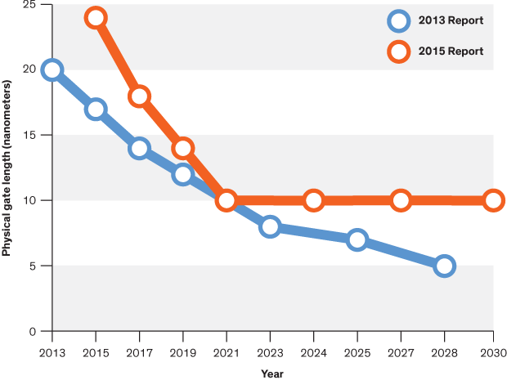
Challenges in CMOS Performance
f vs. year
Vdd vs. L
Energy ~ Vdd² × C
Power ~ Vdd² × C × f
C ~ Cox × W × L
Cox ~ 1/tox
f ~ 1/delay
Power vs. year
L vs. year
delay~ W × L × 1/Vdd
* Vdd is limited by transistor threshold voltage
* tox is limited by leakage current
* W and L is limited by controllability
*Source: Computing’s Energy Problem in ISSCC, http://cpudb.stanford.edu/

Slide 4
Moore’s Law
1963: CMOS
1965: Moore’s Law
  Transistor count doubles every year.
1975: Moore’s Law updated
  Transistor count doubles every two years.
2015: Gordon Moore: «I see Moore’s law dying here in the next decade or so»
2015: Intel confirming the slowdown in pace of advancement, from two to two and a half years.
  Uncertainty, probabilistic phenomena
  Fabrication challenges
  Power challenges
New technologies and computing paradigms emerge, especially in the last decade
“The number of people predicting the death of Moore's law doubles every two years.”

Slide 5
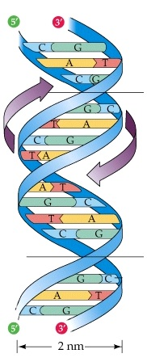
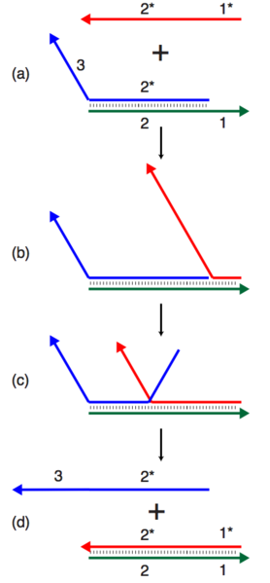
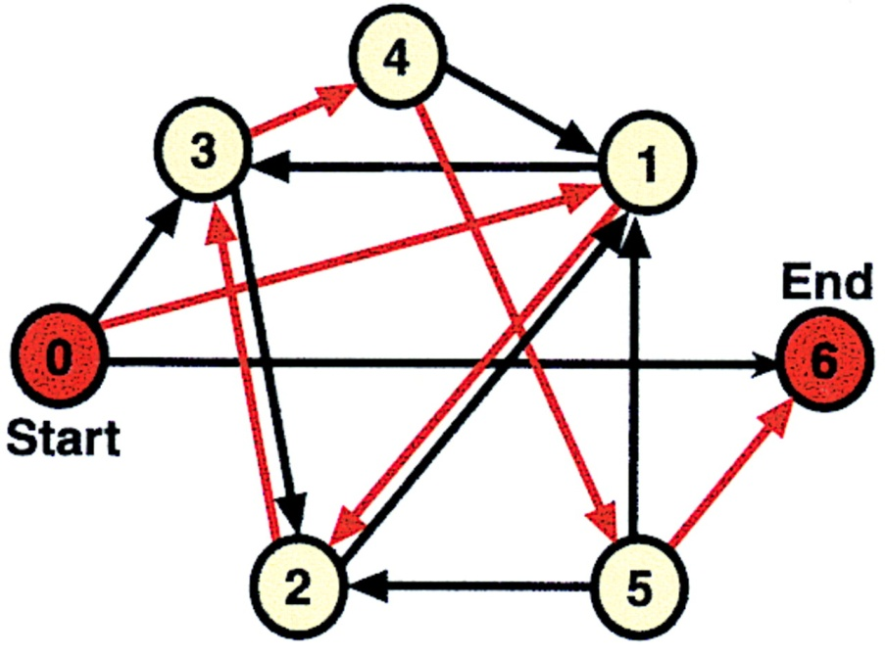
Emerging Technologies
Main goal: to beat CMOS
New technologies requiring new computing paradigms
New technologies using CMOS computing paradigm
New computing paradigms adaptable with CMOS technology
DNA computing: A test tube of DNA can contain trillions of strands for parallel computing
Adleman’s motivating experiment for traveling salesman problem,1994
DNA strand displacement
DNA Strand Displacement (DSD) tool by Microsoft

Slide 6
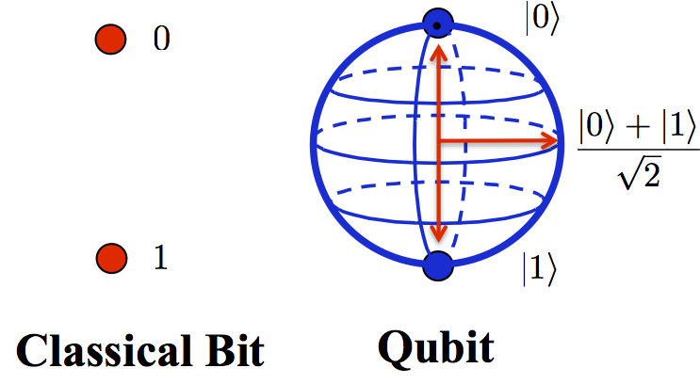
Emerging Technologies
Main goal: to beat CMOS
New technologies requiring new computing paradigms
New technologies using CMOS computing paradigm
New computing paradigms adaptable with CMOS technology
Quantum computing: Theoretically, quantum computers solve RSA-2048 problem in seconds compared to 10 billion years.
RSA numbers are semi-prime numbers used in criptology. For each RSA number n, there exist prime numbers p and q such that n = p × q.
15 = 3 × 5
77 = 7 × 11
4633 = 41 × 113
A real IBM Q quantum processor with 20 qubits can be used online
Cracking RSA keys – up to 200.000 USD Prize.

Slide 7
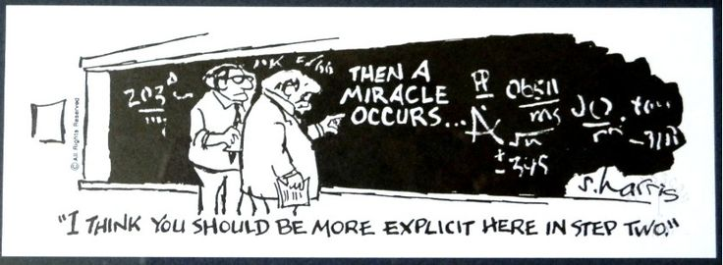
Emerging Technologies
Main goal: to beat CMOS
New technologies requiring new computing paradigms
New technologies using CMOS computing paradigm
New computing paradigms adaptable with CMOS technology
“ A person with a new idea is a crank until the idea succeeds.” - Mark Twain

Slide 8
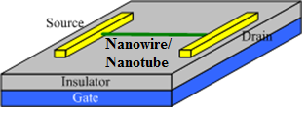
Emerging Technologies
Main goal: to beat CMOS
New technologies requiring new computing paradigms
New technologies using CMOS computing paradigm
New computing paradigms adaptable with CMOS technology
Computing with nanowire/nanotube transistors
Some advantages over CMOS
Interconnection problems
Lack of integration
Fabrication costs
“We can't solve problems by using the same kind of thinking we used when we created them.” - Albert Einstein
Nanowire/nanotube transistor

Slide 9
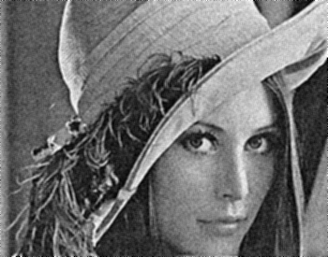

Emerging Computing
Main goal: to beat CMOS
New technologies requiring new computing paradigms
New technologies using CMOS computing paradigm
New computing paradigms adaptable with CMOS technology
Approximate computing: Area and power reduction at the cost of accuracy for applications not requiring high accuracy (image processing, learning)
Mean filtering with exact and app. 8-bit ripple-carry adders
Exact 1-bit adder (48 Tran.)
App. 1-bit adder (20 Tran.)

Slide 10
Emerging Computing
Main goal: to beat CMOS
New technologies requiring new computing paradigms
New technologies using CMOS computing paradigm
New computing paradigms adaptable with CMOS technology
“It Is not the Strongest of the Species that Survives but the Most Adaptable” - Charles Darwin
PROPOSED COMPUTING PARADIGM:
Bit Stream Computing (BSC)
inspired by Stochastic Computing (SC)

Slide 11
Probabilistic Computing
Deterministic
Subsequent state of the system is determined deterministically
Probabilistic
Subsequent state of the system is determined probabilistically
Deterministic
Deterministic
Deterministic
Probabilistic

Slide 12
Why Probabilistic Computing?
Strengths
  Easier to implement arithmetic operations.
  Circuit size is small and independent of the number of input bits.
  Suitable for applications not requiring high accuracy (image processing, learning).
Weaknesses
  Accuracy problems.
  Long computational times.
  Costly random number generators are needed.

Slide 13
Why Stochastic Computing?
Easier to implement arithmetic operations.
Stochastic computing (SC) depends on randomly or Binomially distributed bit streams.
Random Bit Streams
Stochastic Computing
0,1,0,1,1,0,1,0
x
x=4/8
P(x=1) = 4/8
AND
z
y=2/8
0,1,0,0,0,1,0,0
y
P(y=1) = 2/8

Slide 14
Why Stochastic Computing?
Stochastic circuit
Probabilistic
Deterministic
Probabilistic
p₁=2/6, p₂=2/6, p₃=2/6, p₄=1/6, p₅=5/6, p₆=2/6

Slide 15
Arithmetic Operations with SC
Multiplication: : x x y = z
3-bit deterministic multiplier (30 gates)
3-bit stochastic multiplier (1 gate)
x=(0.100)₂
AND
z=(0.010)₂
y=(0.100)₂
Area cost of an n bit multiplier?
At least how many stream bits for an n bit multiplier?

Slide 16
Arithmetic Operations with SC
Scaled addition: : z=x(s) + y(1-s), s=0.5
Averaging the inputs
1,1,1,1,1,0,1,1
1
MUX
1,0,1,1,0,0,1,1
x
1
0,0,1,0,0,1,1,0
0
z
MUX
y
0
1,0,0,1,0,1,0,1
s
x=7/8, y=3/8, s=4/8, z=5/8

Slide 17
Why Stochastic Computing?
Circuit size is small and independent of the number of input bits.
How about considering the cost of random number generators?
Each input needs a separate generator, generally LFSR based.
Conventional Binary
Computing
Stochastic Computing
  Area
  Area
  Resolution
  Resolution

Slide 18
Input Dependency of SC
x=4/8
AND
z
x=4/8
0,1,0,1,1,0,1,0
0,1,0,1,1,0,1,0
0,1,0,1,1,0,1,0
z=4/8
Input streams are independent
Each input requires a separate generator

Slide 19
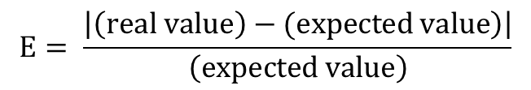
Accuracy of SC
x=4/8
AND
z
y=2/8
0,1,0,1,1,0,1,0
z=1/8
0,1,0,0,0,1,0,0
Which one is right?
0,1,0,1,1,0,1,0
z=2/8
0,1,0,0,1,0,0,0
0,1,0,1,1,0,1,0
z=0/8
1,0,0,0,0,1,0,0

Slide 20
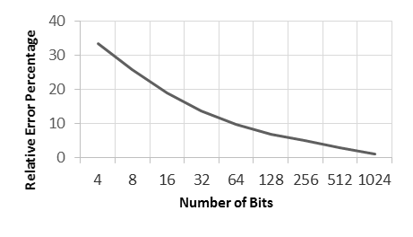
Accuracy of SC
The longer the streams the more accurate the computing.
1 gate vs. 1000 gates doing the same job having the same accuracy
Explains why SC could not become a real competitor to conventional computing although it offers significant area advantage.
Low accuracy or long computing times is the main obstacle in front of SC.

Slide 21
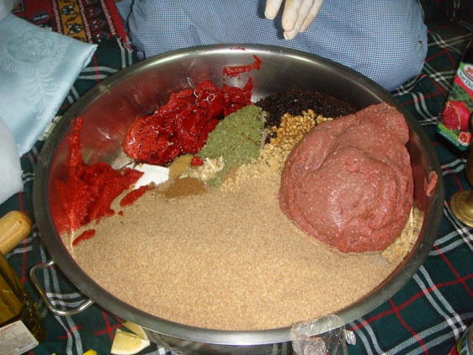
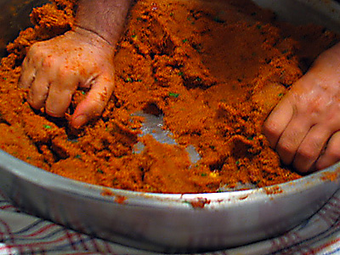
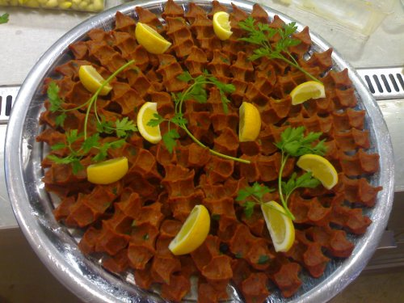
Performance of Randomness
Ingredients of “Çiğ Köfte”
Kneading “Çiğ Köfte”
Ready to serve “Çiğ Köfte”
Heterogeneous to Homogeneous: HOW?
The longer the kneading time the tastier the “Çiğ Köfte”.
The longer the kneading time the more homogeneous (accurate) the “Çiğ Köfte”.

Slide 22
Performance of SC
Bit Streams
0,1,0,1,1,0,1,0,…..
The longer the bit streams the more accurate the computation.
The longer the bit streams the slower the computation.
Perfect accuracy (100%) requires infinite number of bits.

Slide 23
Bit Stream Computing (BSC)
Bit Streams
0,1,0,1,1,0,1,0,…..
To improve accuracy and relatively to decrease computing times.
Exploits the logic used in stochastic computing, but not necessarily employ randomly distributed bit streams.
Much smaller arithmetic circuits compared to conventional binary ones

Slide 24
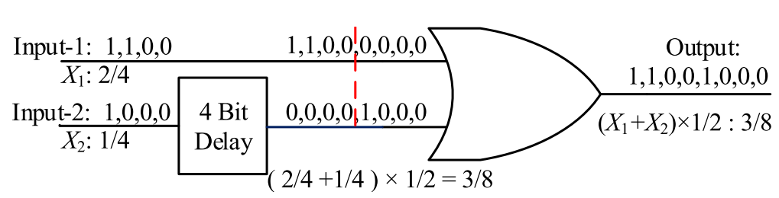
Accurate Adder with BSC
Adder with 4 bit inputs and 8 bit output
Delay block and an OR gate
Delay amount is the time duration of the input stream
n bit input
2n bit output
100% accurate
Area comp. O(n)

Slide 25
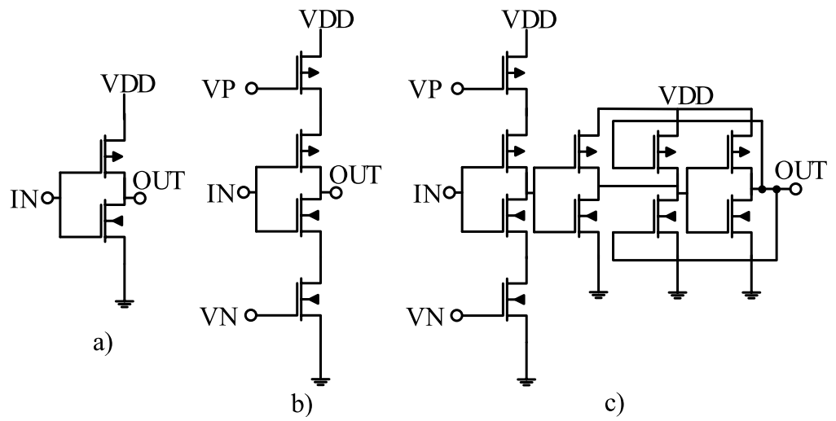
Delay Block
Delay is achieved with inverter chains.
n bit delay needs n inverters

Slide 26
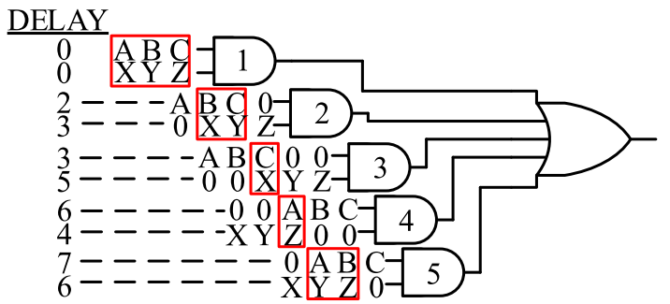
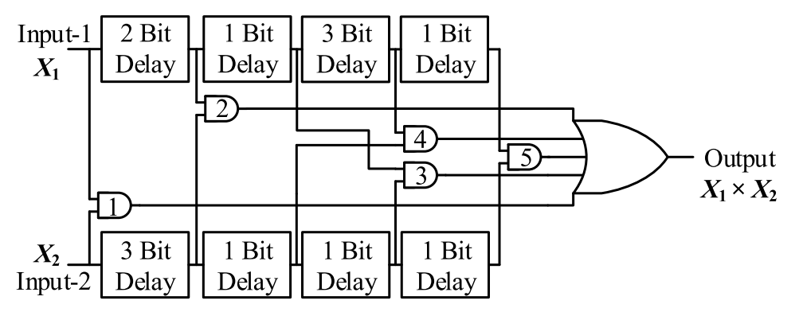
Accurate Multiplier with BSC
100% accurate
n bit input
n² bit output
Multiplier with 4 bit inputs and 16 bit output
Area comp. O(n²)

Slide 27
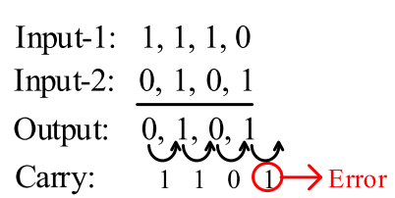
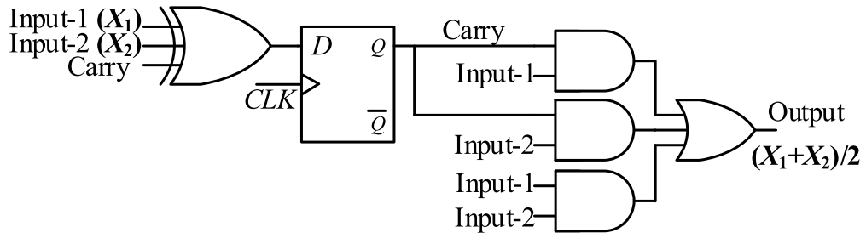
Semi-Accurate Adder with BSC
Almost 100% accurate
n bit input
n bit output
Area comp. O(1)

Slide 28
Summary of the Proposed

Slide 29
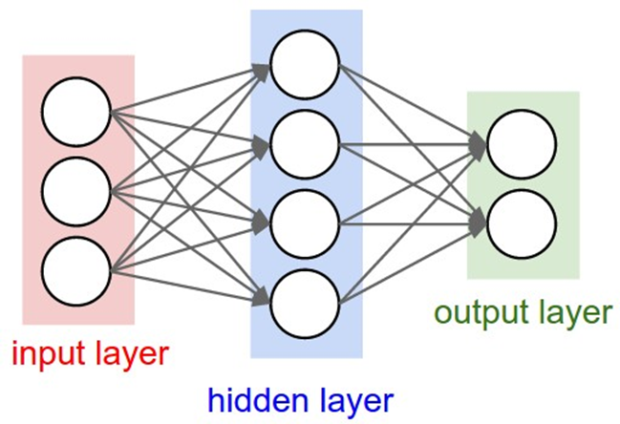
Summary of the Proposed
Upto 10X area improvement compared to conventional binary circuits
Proposed adders and multipliers justified in artificial neural networks
This study opens up new horizons for computing with much smaller yet accurate arithmetic circuits.

Slide 30
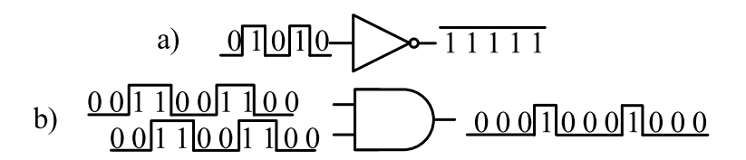

Future Works
Perform more detailed CMOS simulations followed by fabrications by considering area, delay, power, and accuracy with timing variations.
Use the proposed circuits in printable, flexible, or organic electronics that requires small number of transistors.

Slide 31
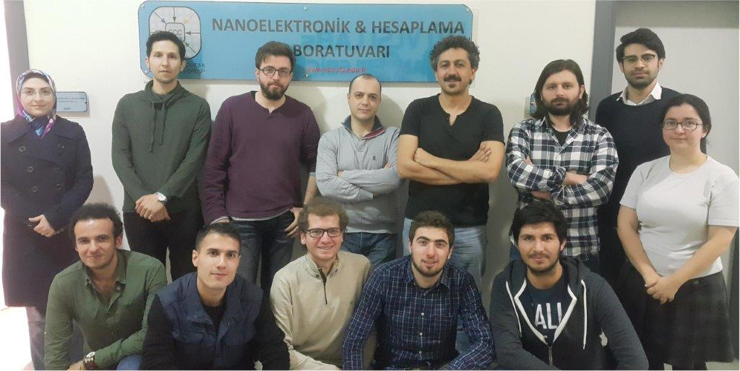

Web: http://www.ecc.itu.edu.tr/
THANK YOU!
This work is part of a project that has received funding from the European Union's H2020 research and innovation programme under the Marie Skłodowska-Curie grant agreement No 691178.
This work is supported by the TUBITAK-Career project #113E760, and the TUBITAK-1001 project #116E250.

