Slide 1

ELE 523E
COMPUTATIONAL NANOELECTRONICS
Mustafa Altun
Electronics & Communication Engineering
Istanbul Technical University
Web: http://www.ecc.itu.edu.tr/
FALL 2016
W7: Approximate Computing & Bayesian Networks, 31/10/2016

Slide 2
Outline
Approximate computing
  Software level
    Appling probabilistic or heuristic methods
    Skipping tasks
    Memoization
  Hardware level
    Voltage and size scaling
    Inexact structures
Bayesian networks
  Modeling dependencies
  Analysis

Slide 3
Why Approximate?
Benefits
  Power saving
  Energy saving
  Time saving
  Area saving
At the cost of accuracy
Parallel Processing
Serial Processing
Power?
Energy?
Time?
Area?

Slide 4
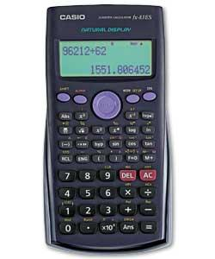
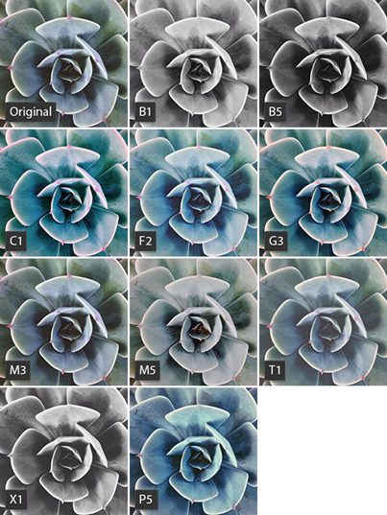

Why Approximate?
Applications
  Problems not having a unique solution
  Solution space is large
  Video, audio, and image applications not requiring perfect accuracy
Calculator
Image processing
Scheduling the exam week with exam dates and hours
Synthesizing a circuit with gates doing a certain task
Finding a logic truth table of a certain task

Slide 5
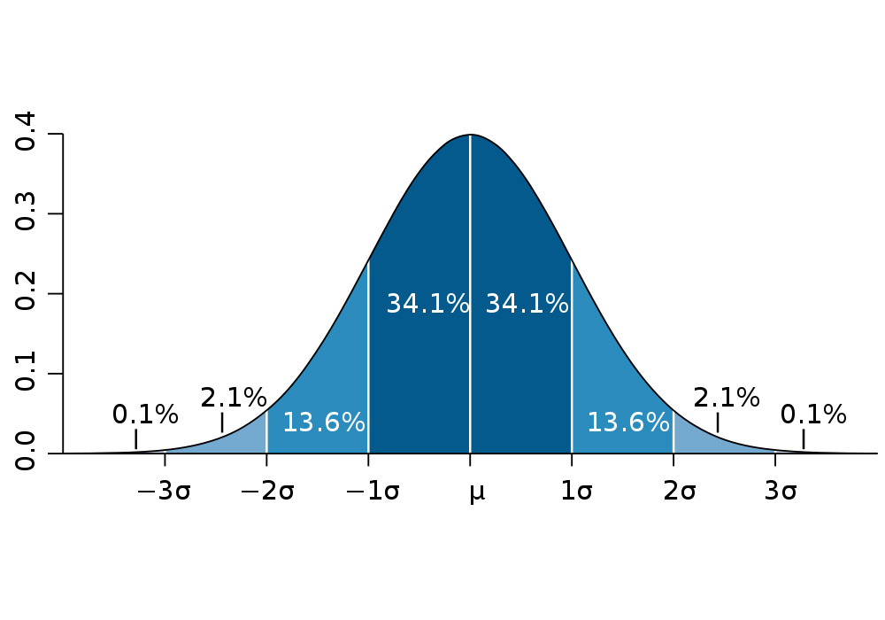
Software Level Approximation
Genetic/evolutionary and heuristic algorithms
Distrubution of random input assignements
Solution Space

Slide 6
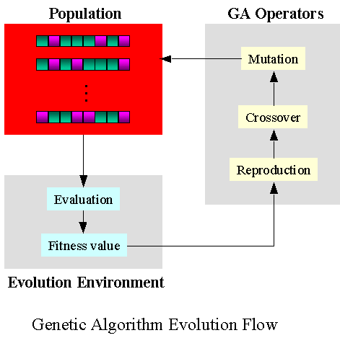
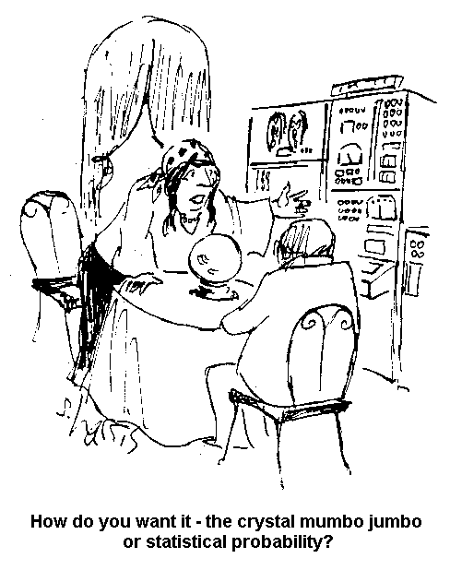
Software Level Approximation
Genetic/evolutionary and heuristic algorithms

Slide 7
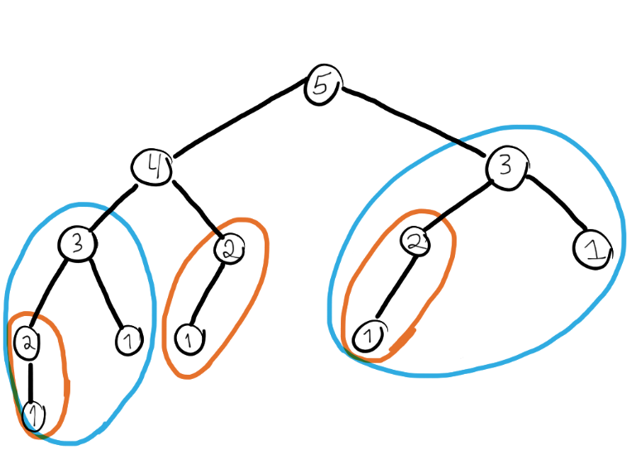


Software Level Approximation
Memoization: remembering the past, use for the future
Our brains use it all the time. How about accuracy?
Suitable for applications having small variances.
Low variance

Slide 8
Hardware Level Approximation
Voltage scaling
Ideally zero variance; decreasing Vdd results in a variance increase
* Probabilistic CMOS technology: A survey and future directions

Slide 9
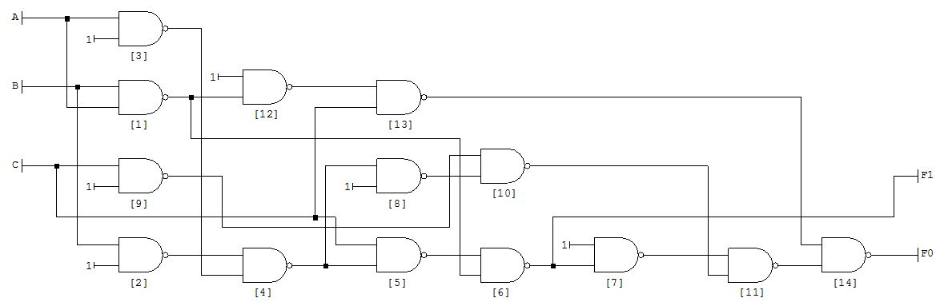
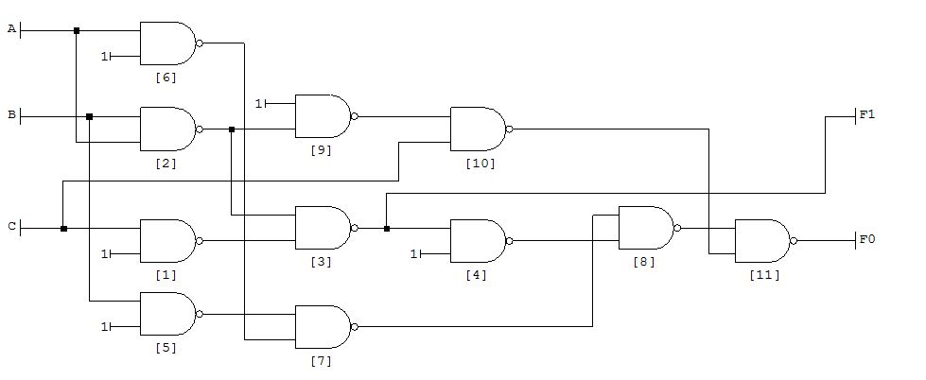
Hardware Level Approximation
Approximate circuits are achieved by changing truth tables or target Boolean functions.
Exact adder (14 Gates)
App. adder (11 Gates)

Slide 10

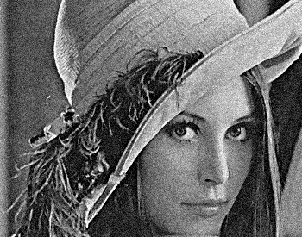

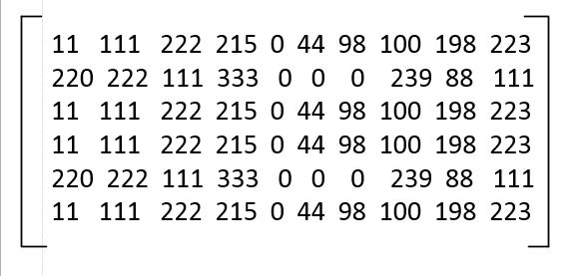
App. Adders for Image Processing
Noise
Matrix
Mean filter with Approximate adders

Slide 11
App. Adders for Image Processing
Mean filter
New value= (11+111+222+220+222+111+11+111+222)/9=134

Slide 12
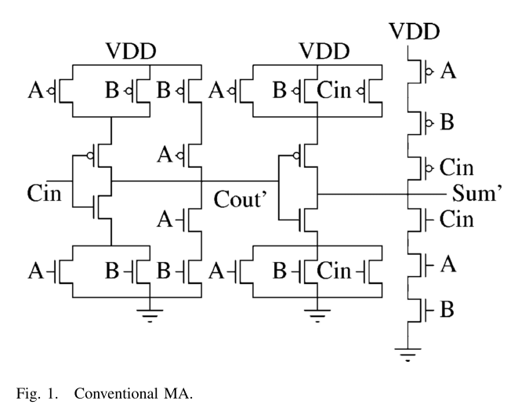
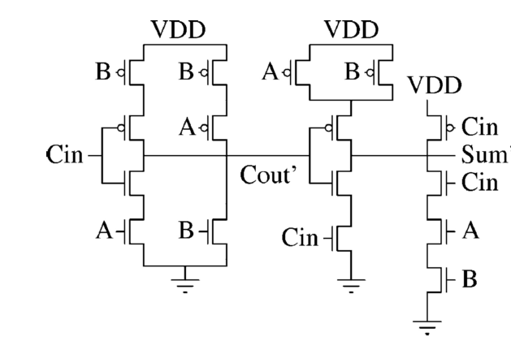
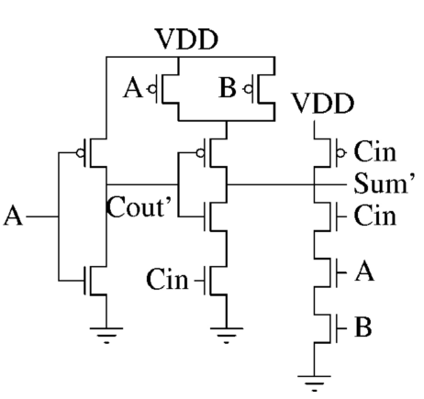
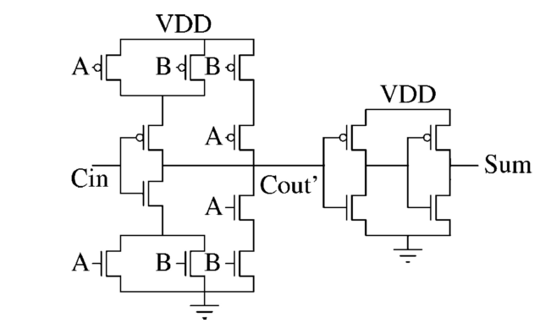
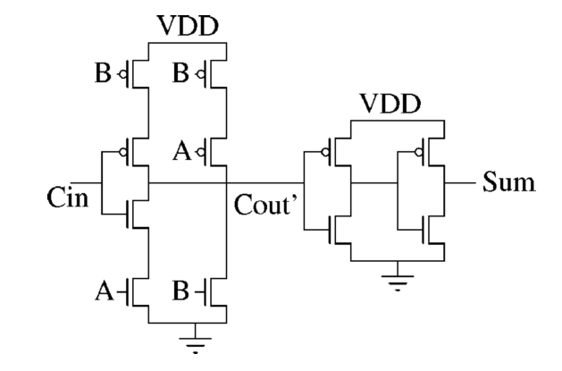
Approximate 1-bit Full Adders
Approximate 1
Accurate Adder
Approximate 2
Approximate 3
Approximate 4

Slide 13
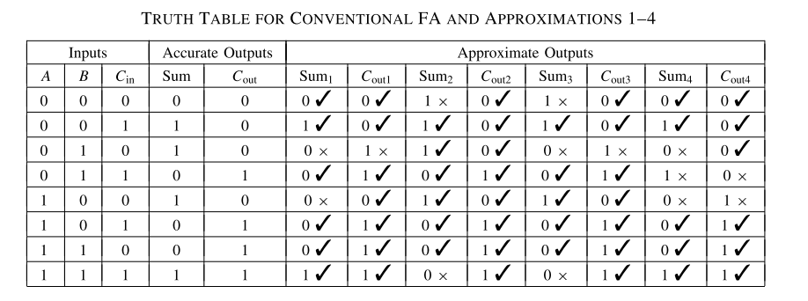
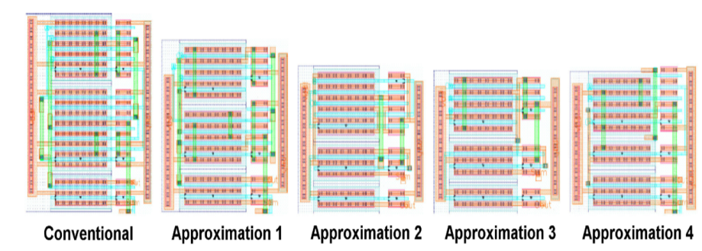
Approximate 1-bit Full Adders
IMPACT: imprecise adders for low-power approximate computing

Slide 14
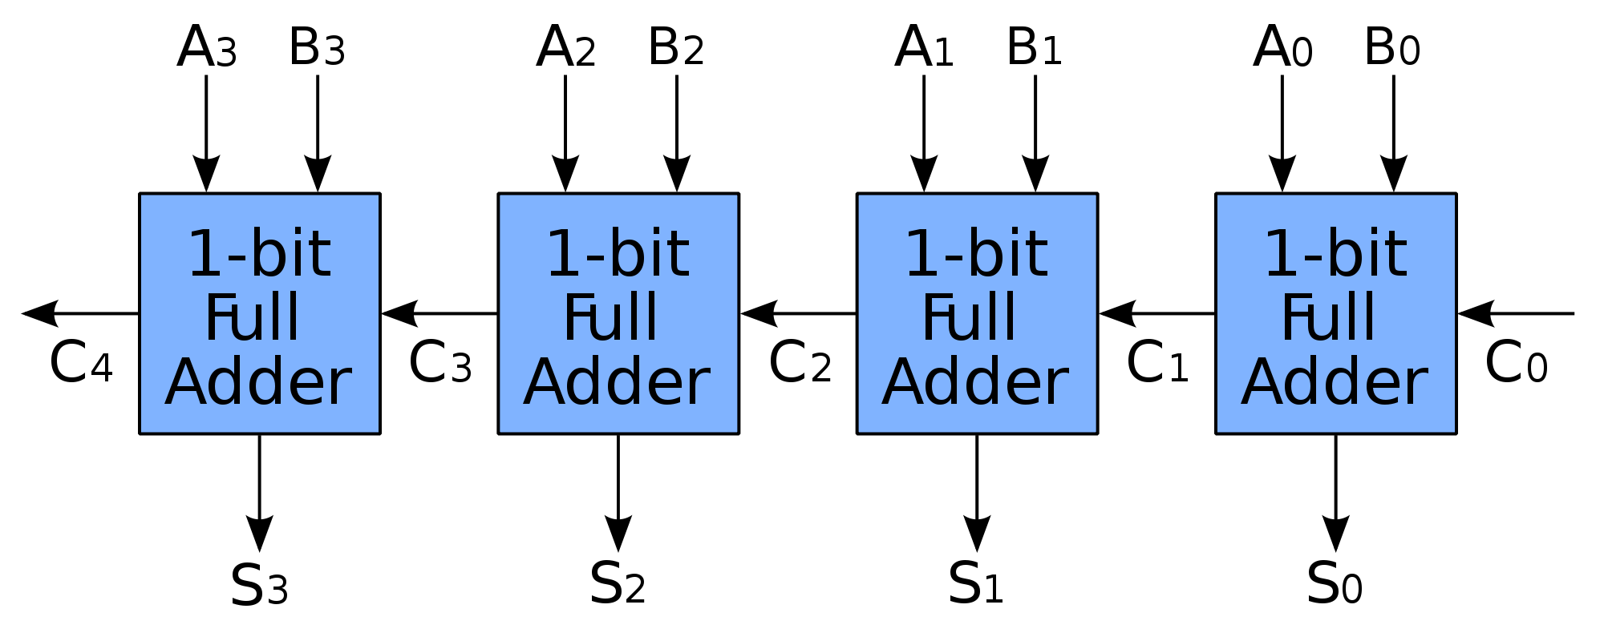
Approximate Ripple Carry Adders
Most significant
Least significant
Which full adders are approximate?
How to calculate an average error?

Slide 15
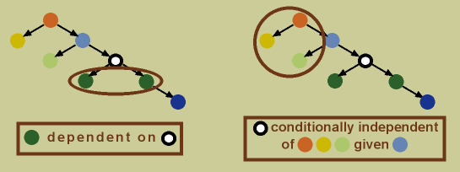
Bayesian Network
A probabilistic directed graph model.
To model dependencies between random variables.
Used to model probabilistic behaviors of nano scale networks such as random defects and probabilistic devices.

Slide 16
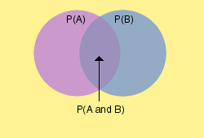
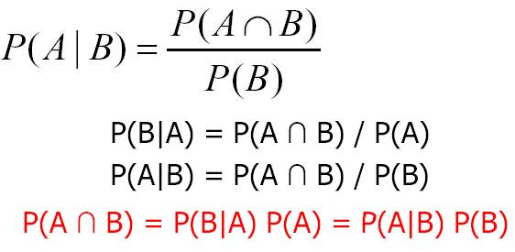
Conditional Probability
P(A | B): Probability that A happens given that B has happened.
Are A and B independent?

Slide 17



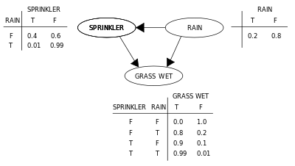
Bayesian Network

Slide 18
Bayesian Network
P(S=T | R=T)=?
P(S=T, R=T )=?
P(G=T, S=T, R=T )=?
P(S=T, R=F )=?
P(G=T, S=T | R=T )=?
P(S=F, R=T )=?
P(S=F, R=F )=?

Slide 19
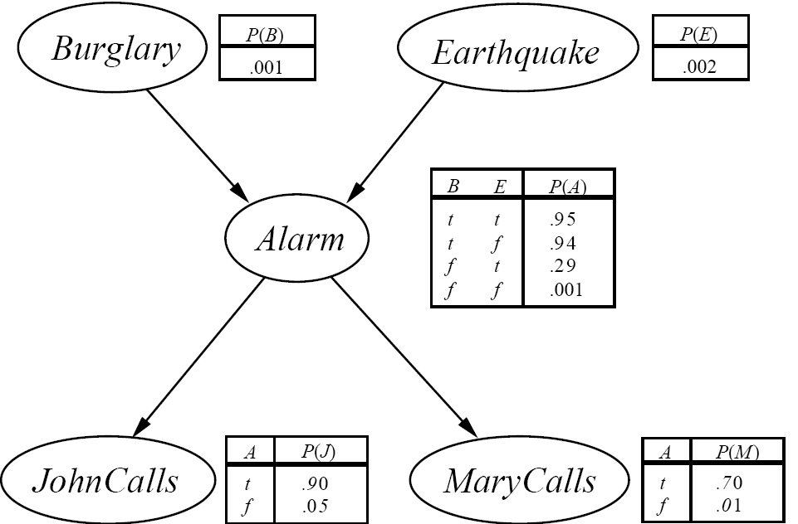
Bayesian Network
P(J, M, A, E, B)=?

Slide 20
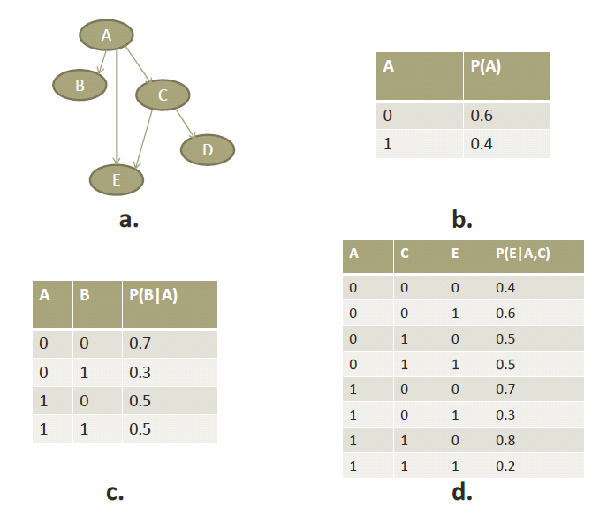
Error Analysis with Bayesian Networks
A, B, C, D, and E can be any circuit part.
Suppose that A, B, C, D, and E are gates.
P(A): Probability that there is an error at the output of A, i.e., the output of A is incorrect.
P(B|A): Probability that the output of B is incorrect, given that the output of the gate A is incorrect.
P(E|A,C): Probability that the output of E is incorrect, given that the output of the gates A and C are both incorrect.
One-directional Bayesian network to model
errors/defects in circuits

Slide 21
Suggested Readings
Mittal, S. (2016). A survey of techniques for approximate computing. ACM Computing Surveys (CSUR), 48(4), 62.
Han, J., & Orshansky, M. (2013, May). Approximate computing: An emerging paradigm for energy-efficient design. In 2013 18th IEEE European Test Symposium (ETS) (pp. 1-6). IEEE.
Gupta, V., Mohapatra, D., Park, S. P., Raghunathan, A., & Roy, K. (2011, August). IMPACT: imprecise adders for low-power approximate computing. In Proceedings of the 17th IEEE/ACM international symposium on Low-power electronics and design (pp. 409-414). IEEE Press.

