Slide 1

ELE 523E
COMPUTATIONAL NANOELECTRONICS
Mustafa Altun
Electronics & Communication Engineering
Istanbul Technical University
Web: http://www.ecc.itu.edu.tr/
FALL 2016
W6: Probabilistic Computing, 24/10/2016

Slide 2
Outline
Overview of probabilistic computing
  Strengths
  Weaknesses
  Application areas
Stochastic computing with logic gates
  Circuit analysis
  Synthesis of stochastic inputs
  Synthesis of polynomial functions
Probabilistic switches
  Two-terminal switches
  Four-terminal switches and percolation

Slide 3
Probabilistic Computing
Deterministic
Subsequent state of the system is determined deterministically
Probabilistic
Subsequent state of the system is determined probabilistically
Deterministic
Deterministic
Deterministic
Probabilistic

Slide 4
Why Probabilistic Computing?
Strengths
  Easier to implement arithmetic operations.
  Works efficiently in encoding/decoding
  High degree of transient error tolerance.
  Exploit randomness that is a fact in nanoscale.
  Used in modeling probabilistic behavior of nanotechnologies.
Weaknesses
  Accuracy problems.
  Long computational times.

Slide 5
Stochastic Computing
Stochastic computing (SC) is a probability computing that depends on random bit streams.
Random Bit Streams
Stochastic Computing
0,1,0,1,1,0,1,0
x
P(x=1) = 4/8
x=4/8
AND
z
y=2/8
0,1,0,0,0,1,0,0
y
P(y=1) = 2/8

Slide 6
Random Bit Streams
Randomly assigning each bit value
CONVENTIONAL
The stream probability p represents the probability of having 1 for each bit
The stream has a binomial distribution in terms of the number of 1s
Less accurate
Perfectly random
Randomly shuffling a bit stream
The stream probability p represents (total number of 1s)/(total number of bits)
The stream has a deterministic behaviour in terms of number of 1s
More accurate
The longer the streams the closer these methods.

Slide 7
Stochastic Computing
Stochastic circuit
Probabilistic
Deterministic
Probabilistic
p₁=2/6, p₂=2/6, p₃=2/6, p₄=1/6, p₅=5/6, p₆=2/6

Slide 8
Accuracy of SC
x=4/8
AND
z
y=2/8
0,1,0,1,1,0,1,0
z=1/8
0,1,0,0,0,1,0,0
Which one is right?
0,1,0,1,1,0,1,0
z=2/8
0,1,0,0,1,0,0,0
0,1,0,1,1,0,1,0
z=0/8
1,0,0,0,0,1,0,0

Slide 9
Accuracy of SC
x=4/8
AND
z
x=4/8
0,1,0,1,1,0,1,0
0,1,0,1,1,0,1,0
0,1,0,1,1,0,1,0
z=4/8
Dependency is important!
Conventionally, input streams are independent

Slide 10
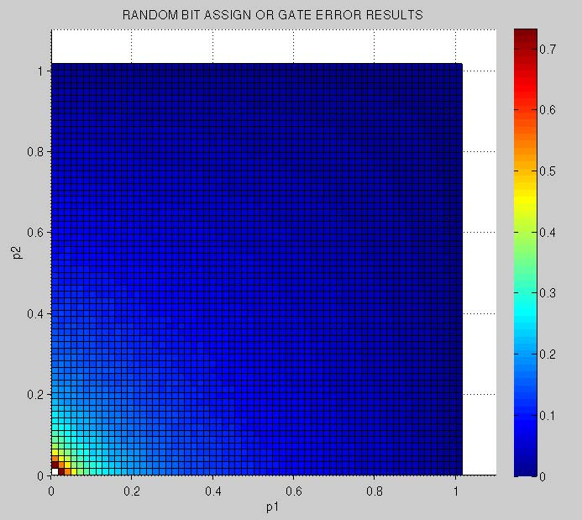
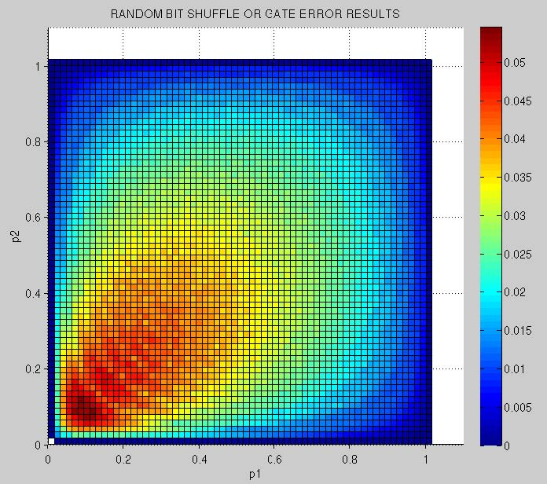
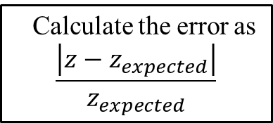
Accuracy of SC
Randomly assigning each bit value
CONVENTIONAL
The stream probability p represents the probability of having 1 for each bit
The stream has a binomial distribution
Randomly shuffling a bit stream
The stream probability p represents (total number of 1s)/(total number of bits)
Calculate the error rate?
Calculate the error as
$$\frac{\left|z−z_{expected}\right|}{z_{expected}}$$
AND

Slide 11
Randomly Assigning
Example:
Consider 4-bit input bit streams x and y such that each bit is 1 with an independent probability of p=1/2.
Find the probability of accurate computation z=1/4.
Find the probability of having z=0/4.
Find the probability of having z=2/4.
Find the probability of having z=3/4.
Find the probability of having z=4/4.
Find the everage error rate.
x=2/4
AND
z
y=2/4

Slide 12
Randomly Shuffling
Example:
Consider randomly distributed 4-bit input bit streams x and y such that half of its bits are 1 and the other half 0.
Find the probability of accurate computation z=1/4.
Find the probability of having z=0/4.
Find the probability of having z=2/4.
Find the probability of having z=3/4.
Find the probability of having z=4/4.
Find the everage error rate.
x=2/4
AND
z
y=2/4

Slide 13
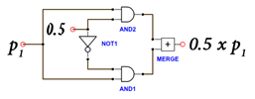
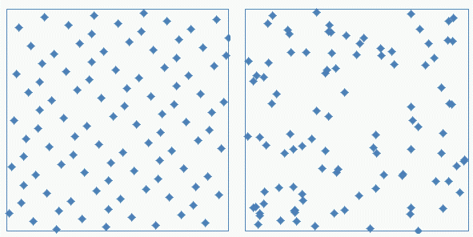
Improving the Accuracy
Using correlated bit streams
Error-free computing
Using quasi-random bit streams
1 gate vs. 1000 gates doing the same job
Low-discrepancy vs. random sequence

Slide 14
Defect Tolerance in SC
x=4/8=(0.100)₂
AND
z=1/8=(0.001)₂
y=2/8=(0.010)₂
What if there is a bit-flip in an input?
0,1,0,1,1,0,1,0
z=1/8
0,1,0,0,0,1,0,0
(0.100)₂ x (0.010)₂ = (0.001)₂

Slide 15
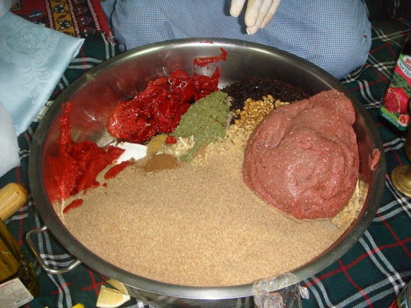
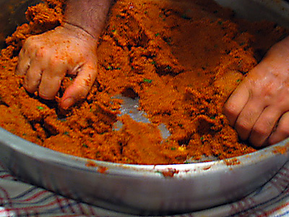
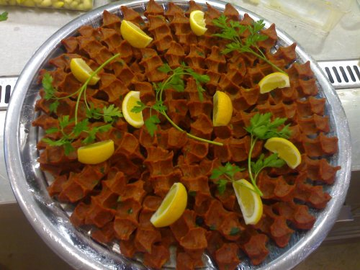
Performance of Randomness
Ingredients of “Çiğ Köfte”
Kneading “Çiğ Köfte”
Ready to serve “Çiğ Köfte”
Heterogeneous to Homogeneous: HOW?
The longer the kneading time the tastier the “Çiğ Köfte”.
The longer the kneading time the more homogeneous (accurate) the “Çiğ Köfte”.

Slide 16
Performance of SC
Bit Streams
0,1,0,1,1,0,1,0,…..
The longer the bit streams the more accurate the computation.
The longer the bit streams the more reliable the computation.
The longer the bit streams the slower the computation.

Slide 17
Arithmetic Operations with SC
Multiplication: : x x y = z
3-bit deterministic multiplier (30 gates)
3-bit stochastic multiplier (1 gate)
x=(0.100)₂
AND
z=(0.010)₂
y=(0.100)₂
At least how many bits shoud a stream have?
At least how many stream bits for an n-bit multiplier?

Slide 18
Arithmetic Operations with SC
Scaled addition: : x(s) + y(1-s) = z
1,1,1,1,1,0,1,1
1
x
1
MUX
1,0,1,1,0,0,1,1
z
0,0,1,0,0,1,1,0
0
MUX
y
0
1,0,0,1,0,1,0,1
s
x=7/8, y=3/8, s=4/8, z=5/8

Slide 19
Arithmetic Operations with SC
Example:
Find the expression of z for both stochastic and deterministic inputs applied.
x₁
AND
1
x₂
MUX
NOT
z
x₃
0
x₄

Slide 20
Synthesis Problem-1
Problem: How to construct a logic circuit in order to implement given output probabilities with a set of input probabilities?
Example:
Implement output probabilities 0.6, 0.2, and 0.3 with using input probabilities of 0.4 and 0.5.
P(x = 1) = 0.4
P(x = 1) = 0.4
0,0,1,0,1,0,1,0,1,0
0,1,0,1,0,0,1,1,0,0
P(z = 1) = 0.3
P(z = 1) = 0.2
P(x = 1) = 0.4
P(z = 1) = 0.6
0,1,0,0,0,1,0,0,0,1
0,0,0,1,0,0,1,0,0,0
1,0,1,1,0,1,0,0,0,0
0,1,0,0,1,0,1,1,1,1
1,0,0,1,1,0,0,1,1,0
1,0,1,1,0,0,1,0,0,1
P(y = 1) = 0.5
P(y = 1) = 0.5
P(z = 1) = P(x = 0)
P(z = 1) = P(x = 0) P(y = 0)
P(z = 1) = P(x = 1) P(y = 1)

Slide 21
Synthesis Problem-1
Theorem (Qian et al. 2011): With input probabilities = {0.4, 0.5}, we can synthesize arbitrary decimal output probabilities.
Example: Synthesize q = 0.757
(Black dots
are inverters)

Slide 22
Synthesis Problem-2
Problem: How to construct a logic circuit in order to implement a polynomial g(t) where both t and g(t) are in unit interval?

Slide 23
Synthesis Problem-2
Example:
Implement g(t) = 3/8 t² + 5/8 t.
t
AND
1
t
g(t)
MUX
t
0
3/8

Slide 24
Synthesis Problem-2
Example:
Implement g(t) = t³ – 2t² + 1.
t
NOR
1
t
g(t)
MUX
1
0
t

Slide 25
Synthesis Problem-2
Example:
Implement g(t) = 9/4 t² – 15/8 t + 5/8 and test on g(1/2).
t
t
t
5/8
0
0
1
MUX
g(t)
1/8
2
1
3

Slide 26
Synthesis Problem-2
Theorem (Qian et al. 2012): With using Bernstein polynomials, we can synthesize any polynomial g(t).
Example:
Implement g(t) = 9/4 t² – 15/8 t + 5/8.
g(t) = 9/4 t² – 15/8 t + 5/8
= 5/8 B₀ + 0 B₁ + 1/8 B₂ + 1 B₃
B_{i} = probability that the output of the adding unit is i.
B₀ = (1-t)³
B₁ = 3 t(1-t)²
B₂ = 3 t²(1-t)
B₃ = t³

Slide 27
Probabilistic Two-Terminal Switch
A probabilistic switch is ON with a probability of p.
Can be implemented with stochastic bit streams.
0,1,0,1,1,0,1,0
x
P(x=1) = p = 4/8
Can be used to model probabilistic phenomena in nanoscale such as random defects.

Slide 28
Probabilistic Two-Terminal Switch
A probabilistic MOS is a probabilistic switch.
* Probabilistic CMOS technology: A survey and future directions

Slide 29
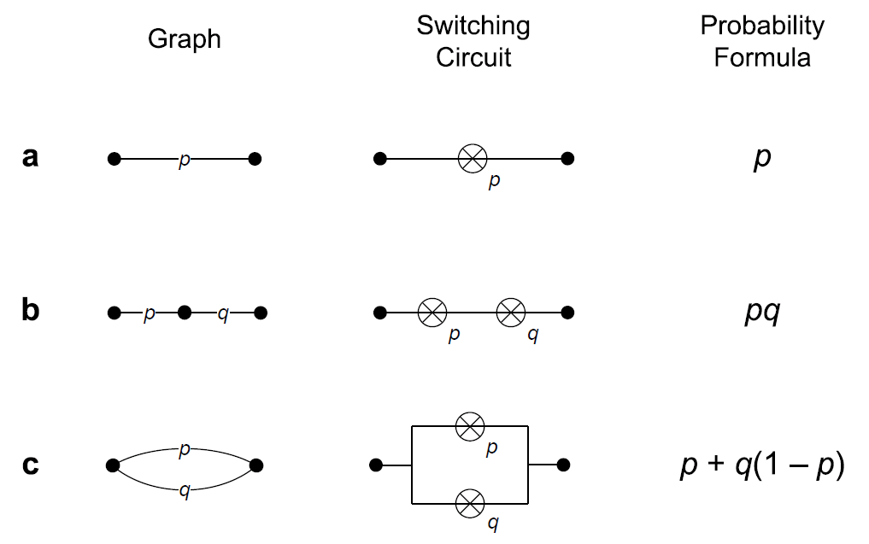
Probabilistic Two-Terminal Switch

Slide 30
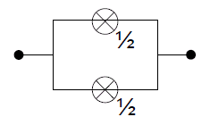
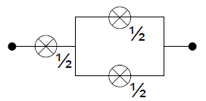
Synthesis Problem
Problem: How to construct a circuit in order to implement a given binary decimal numbers using p-switches with p=1/2 ?
Example:
Implement the output probabilities 0.11₂ and 0.011₂ with p-switches with p=1/2.
0.11₂
0.011₂

Slide 31
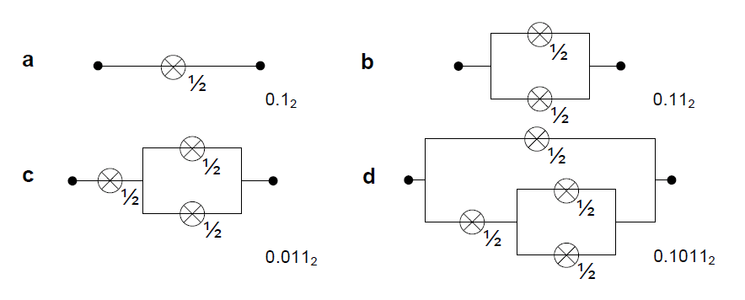
Synthesis Problem
Example:
Implement the output probability 0.1011₂ with p-switches with p=1/2.
Progressing from the least-significant to the most-significant bits

Slide 32
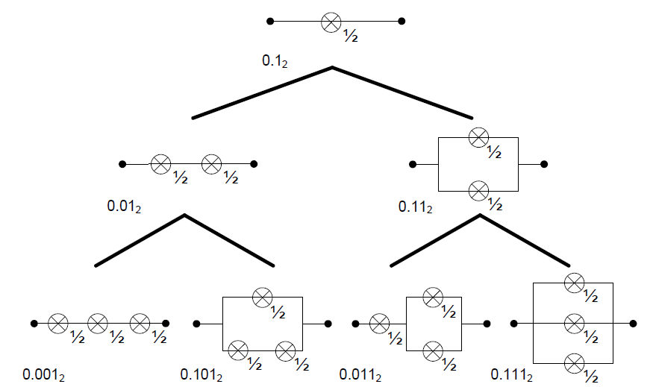
Synthesis Problem
Binary tree showing how to generate all possible switching circuits
(Wilhelm et al. 2008)

Slide 33
Probabilistic Four-Terminal Switch
A probabilistic switch is ON with a probability of p.
Can be implemented with stochastic bit streams.
0,1,0,1,1,0,1,0
x
P(x=1) = p = 4/8
Can be used to model probabilistic phenomena in nano-crossbar arrays such as random defects.

Slide 34
Probabilistic Four-Terminal Switch
Find the probability of having a path between top-bottom and left-right plates.
How to find the probabilities for larger sizes?
For larger sizes is the probabilistic phenomena increase or decrese?
Use «Percolation Theory»

Slide 35
Percolation Theory
p_{T-B} versus p for 1×1, 2×2, 6×6, 24×24, 120×120, and infinite size lattices.
Each square, representing a four-terminal switch, in the lattice/array is colored black with independent probability p.
p_{T-B} is the probability that a connected path exists between the top and bottom plates.

Slide 36
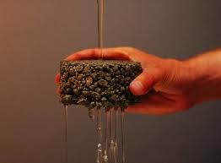
Percolation Theory
Rich mathematical topic that forms the basis of explanations of physical phenomena such as diffusion and phase changes in materials.
Broadbent & Hammersley (1957).

Slide 37
Percolation Theory
Sharp non-linearity in global connectivity as a function of random local connectivity.

Slide 38
Margins
One-margin: Tolerable p₁ ranges for which we interpret p₂ as logical one.
Zero-margin: Tolerable p₁ ranges for which we interpret p₂ as logical zero.
Margins correlate with the degree of deterministic phenomena.

Slide 39
Suggested Readings
Qian, W., & Riedel, M. D. (2008, June). The synthesis of robust polynomial arithmetic with stochastic logic. In Design Automation Conference, 2008. DAC 2008. 45th ACM/IEEE (pp. 648-653). IEEE.
Alaghi, A., & Hayes, J. P. (2013). Survey of stochastic computing. ACM Transactions on Embedded Computing Systems (TECS), 12(2s), 92.
Vahapoglu, E., & Altun, M. (2016, July). Accurate Synthesis of Arithmetic Operations with Stochastic Logic. In VLSI (ISVLSI), 2016 IEEE Computer Society Annual Symposium on (pp. 415-420). IEEE.
Wilhelm, D., & Bruck, J. (2008, July). Stochastic switching circuit synthesis. In Information Theory, 2008. ISIT 2008. IEEE International Symposium on(pp. 1388-1392). IEEE.
Article on probabilistic CMOS: http://www2.technologyreview.com/news/409597/tr10-probabilistic-chips/
Moore, E. F., & Shannon, C. E. (1956). Reliable circuits using less reliable relays. Journal of the Franklin Institute, 262(3), 191-208.

