Slide 1

ELE 523E
COMPUTATIONAL NANOELECTRONICS
Mustafa Altun
Electronics & Communication Engineering
Istanbul Technical University
Web: http://www.ecc.itu.edu.tr/
FALL 2016
W10: Faults and Their Analysis, 14/11/2016

Slide 2
Outline
Definitions: defect, faults, errors, failures…
  Reliability versus quality
Faults in nanoscale
Fault models
  Stuck-at faults
  Transition faults
Fault and failure analysis
  Deterministic
  Probabilistic

Slide 3
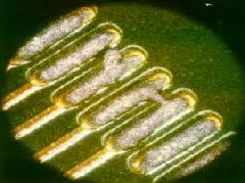
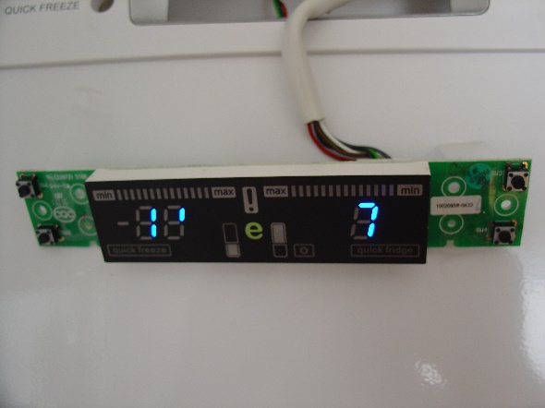
Definitions
Defect: a physical problem
Fault: an abnormal condition or defect
Defect and faults ocur at the component, equipment, or sub-system level which may lead to a failure
Error: incorrect value or information in computing
0
1
Fault/Defect
Error
Failure

Slide 4
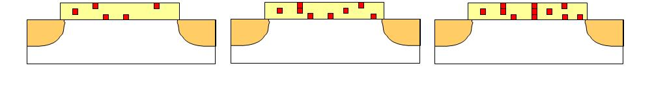
Definitions
Latent Fault/Defect: not causing an error yet
Latent Error: not causing a failure yet
Gate Oxide Breakdown
Latent Defect
Latent Defect
0
1
Don’t Care Condition
0
AND
0
0
1
Latent Error

Slide 5
Definitions
Permanent versus Temporary faults
Permanent versus Transient faults
Pre-field (Quality) versus In-field (Reliability) faults
Fault tolerance: there is fault, but no error
Error tolerance: there is error, but no failure
Quality
Faults happen before first usage
Post-fabrication fault analysis
Relatively easier to fix faults
  Detecting faults followed by reconfiguration or refabrication
Reliability
Faults happen any time in use
Transient probability analysis is needed
Harder to fix faults
  The only way is redundancy
  Dummy devices added

Slide 6
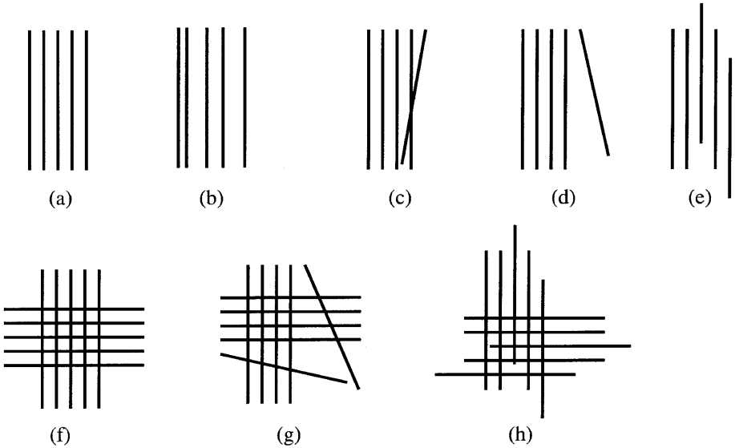
Faults in Nanoelectronics
Faults are the main headache in nanoscale.
  Up to 20% fault ratio in fabrication processes
  Transient fault ratios are also high
  Faults are inevitable and must be handled
Faults in self-assembled nano arrays

Slide 7
Fault Models
Model: a simplified and idealized understanding of physical systems
Models make easier to understand, define, quantify, visualize, or simulate faults
Limitations
  "All models are wrong, but some are useful "«
  More failure mechanisms ⟼ less accurate models
  More fault types ⟼ more complex models, sometimes not realistic
8 different defects with 8 different models
How about model dependencies?

Slide 8
Fault Models
Different components have different reliability predictions
Different components have different transient fault models

Slide 9
Fault Models and Analysis
Stuck-at faults
  Stuck-at 1 and stuck-at 0
  Stuck-at ON and stuck-at OFF
  Stuck-at open and stuck-at shorted (bridging faults)
Transition faults
  Switching faults: 0-to-1 and 1-to-0
  Bit flips
Degradation based faults
Pre-field faults are analyzed/detected by certain deterministic tests
In-field faults are predicted with probability analysis

Slide 10
Stuck-at 1 Fault Anaysis
Fault/Error probability ϵ: a gate constantly evaluates logic 1 (stuck-at 1) with ϵ.
Ideally
With a fault
0
AND
0
0
0
0 with a probability of 1- ϵ
1 with a probability of ϵ
AND
0
1
1
AND
0
0
1
AND
1
1 with a probability of 1
1

Slide 11
Stuck-at 1 Fault Anaysis
Fault/Error probability ϵ: a gate constantly evaluates logic 1 (stuck-at 1) with ϵ.
Ideally
With a fault
0
OR
0
0 with a probability of 1- ϵ
1 with a probability of ϵ
0
0
OR
1
1
1
OR
1
1 with a probability of 1
0
1
OR
1
1

Slide 12
Stuck-at 1 Fault Anaysis
Error/fault probability ϵ : each gate constantly evaluates logic 1 with ϵ.
Example:
What is the probability Px that the circuit produces an incorrect result.
a
OR
b
AND
x
c
Px = (1-c)ϵ + (c)(1-a)(1-b) (1-(1-ϵ)(1-ϵ))

Slide 13
Stuck-at 0 Fault Anaysis
Fault/Error probability ϵ: a gate constantly evaluates logic 0 (stuck-at 0) with ϵ.
Ideally
With a fault
0
AND
0
0
0
AND
0
0 with a probability of 1
1
1
AND
0
0
0 with a probability of ϵ
1 with a probability of 1- ϵ
1
AND
1
1

Slide 14
Stuck-at 0 Fault Anaysis
Fault/Error probability ϵ: a gate constantly evaluates logic 0 (stuck-at 0) with ϵ.
Ideally
With a fault
0
OR
0
0 with a probability of 1
0
0
OR
1
1
1
0 with a probability of ϵ
1 with a probability of 1- ϵ
OR
1
0
1
OR
1
1

Slide 15
Stuck-at 0 Fault Anaysis
Error/fault probability ϵ : each gate constantly evaluates logic 0 with ϵ.
Example:
What is the probability Px that the circuit produces an incorrect result.
a
OR
b
AND
x
c
Px = (c)(1-(1-a)(1-b)) (1-(1-ϵ)(1-ϵ))

Slide 16
Transition Fault Analysis
Error/fault probability ϵ : a gate evaluates the incorrect result, the complement of the correct Boolean value, with ϵ.
Ideally
With a fault
0
AND
0
0
0
0 with a probability of 1- ϵ
1 with a probability of ϵ
AND
0
1
1
AND
0
0
1 with a probability of 1- ϵ
0 with a probability of ϵ
1
AND
1
1

Slide 17
Transition Fault Analysis
Error/fault probability ϵ : a gate evaluates the incorrect result, the complement of the correct Boolean value, with ϵ.
Ideally
With a fault
0
OR
0
0 with a probability of 1- ϵ
1 with a probability of ϵ
0
0
OR
1
1
1
0 with a probability of ϵ
1 with a probability of 1- ϵ
OR
1
0
1
OR
1
1

Slide 18
Transition Fault Analysis
Error/fault probability ϵ : each gate evaluates the incorrect result, the complement of the correct Boolean value, with ϵ.
Example:
What is the probability Px that the circuit produces an incorrect result.
a
OR
b
AND
x
c
Px = ϵ - (2ϵ²- ϵ)c

Slide 19
Transition Fault Analysis
Error/fault probability ϵ : each gate evaluates the incorrect result, the complement of the correct Boolean value, with ϵ.
Example:
What is the probability Py that the circuit produces an incorrect result.
a
c
AND
OR
y
b
c
AND
Py = 3ϵ - 5ϵ² + 2ϵ³- (ϵ - 2ϵ²)(a+b)c + (2ϵ² - 4ϵ³)abc

Slide 20
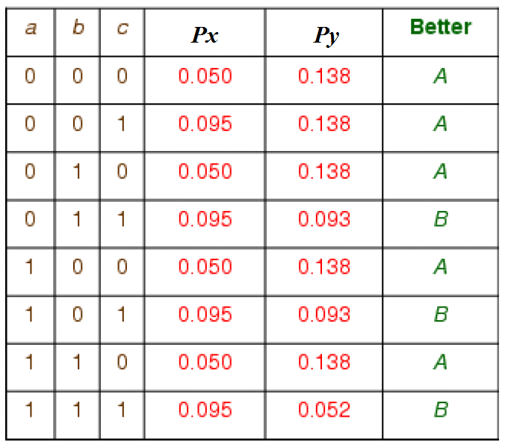
Transition Fault Analysis
Both circuits, A and B, implement the same Boolean function (a+b)c.
Which circuit is better in fault tolerance?
A
Px = ϵ - (2ϵ²- ϵ)c
B
Py = 3ϵ - 5ϵ² + 2ϵ³- (ϵ - 2ϵ²)(a+b)c + (2ϵ² - 4ϵ³)abc

Slide 21
Suggested Readings
Moore, E. F., & Shannon, C. E. (1956). Reliable circuits using less reliable relays. Journal of the Franklin Institute, 262(3), 191-208.
Von Neumann, J. (1956). Probabilistic logics and the synthesis of reliable organisms from unreliable components. Automata studies, 34, 43-98.
Han, J., Taylor, E., Gao, J., & Fortes, J. (2005, July). Faults, error bounds and reliability of nanoelectronic circuits. In 2005 IEEE International Conference on Application-Specific Systems, Architecture Processors (ASAP'05) (pp. 247-253). IEEE.

