Slide 1

ELE 523E
COMPUTATIONAL NANOELECTRONICS
Mustafa Altun
Electronics & Communication Engineering
Istanbul Technical University
Web: http://www.ecc.itu.edu.tr/
FALL 2016
W4: Computing with Nano Arrays, 17/10/2016

Slide 2
Outline
Computing with nano arrays
  Self-assembly
  Two-terminal vs. four-terminal
Arrays of two-terminal devices
  Diode based
  Transistor based
Arrays of four-terminal devices

Slide 3
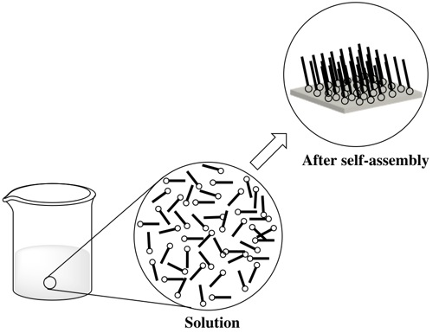
Self-assembly
From disordered to ordered and regular structure

Slide 4
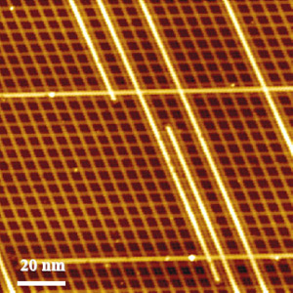
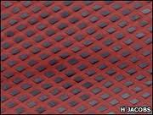
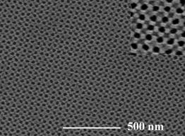
Why Self-assembly?
We prefer order to disorder.
Living cells self-assemble.
Self-assembly is practical to manufacture nano structures.
Self-assembled nano structures

Slide 5
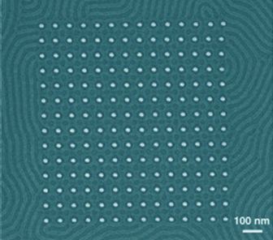
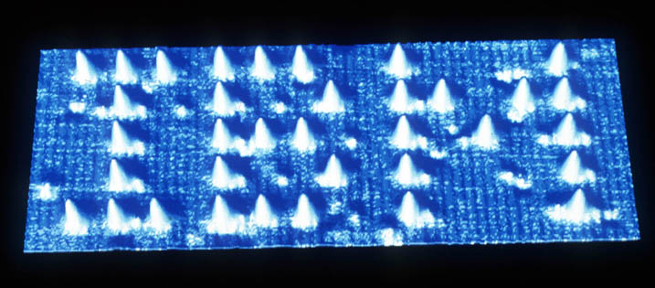
Why Self-assembly?
Directed assembly
  Advantages
    Results in a functional construct from a print/layout
  Disadvantages
    Costly in nanoscale
    Time consuming
Self assembly
  Advantages
    Fast and efficient in nanoscale
    Results in condensed structures
  Disadvantages
    Not results in a functional construct

Slide 6
Research on Self-assembly
VİDEOS FROM LABS:
Video-1: Self-Assembly of Lithographically Patterned 3D Micro/Nanostructures
Lab: Gracias Lab
University: John Hopkins University
URL: http://www.youtube.com/watch?v=GL0im9b6GgU
Video-2: It's Not Magic: Watch How Smart Parts Self-Assemble
Lab: Self-assembly Lab
University: Massachusetts Institute of Technology (MIT)
URL: http://www.youtube.com/watch?v=GIEhi_sAkU8

Slide 7
Nano Arrays
REGULAR
NANO
ARRAYS
SELF
ASSEMBLY

Slide 8
Modelling Nano Arrays

Slide 9
Two-terminal Diode-based Model

Slide 10
Two-terminal Diode-based Model
Example:
Implement the Boolean function f = A+B with diode based nanoarrays.
Diode-resistor logic

Slide 11
Two-terminal Diode-based Model
Example:
Implement the Boolean function f = A B with diode based nanoarrays.
Diode-resistor logic

Slide 12
Two-terminal Diode-based Model
Example:
Implement the Boolean function f = A B + C D with diode based nanoarrays.

Slide 13
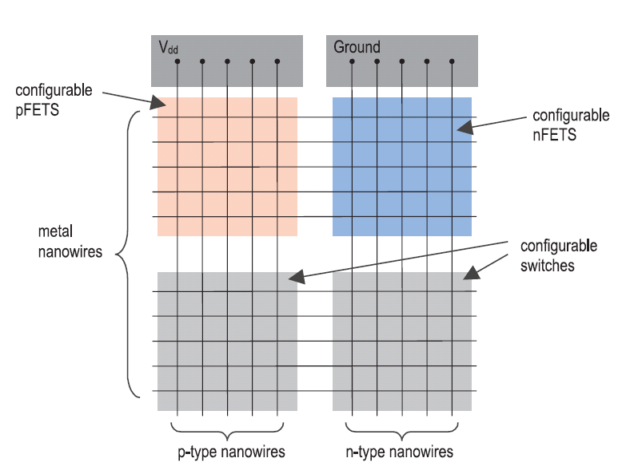
Two-terminal FET-based Model
From Snider, G., et al., (2004). CMOS-like logic in defective, nanoscale crossbars. Nanotechnology.

Slide 14
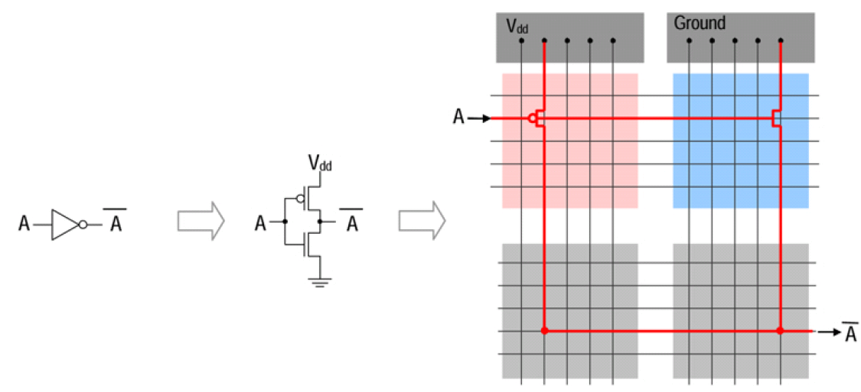
Two-terminal FET-based Model
Example:
Implement the Boolean function f = Aꞌ with CMOS based nanoarrays.

Slide 15
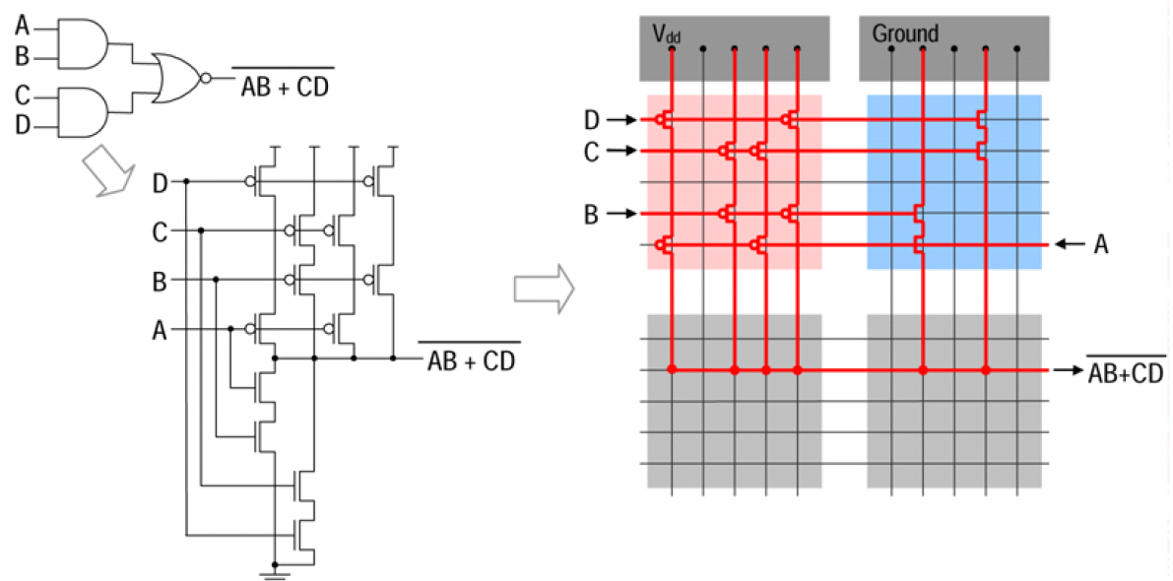
Two-terminal FET-based Model
Example:
Implement the Boolean function f = (A B + C D)ꞌ with CMOS based nanoarrays.

Slide 16
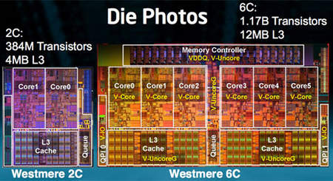
Two-terminal vs. Four-terminal
Shannon’s work: A Symbolic Analysis of Relay and Switching Circuits(1938)

Slide 17
Two-terminal vs. Four-terminal

Slide 18
Two-terminal vs. Four-terminal
What are the Boolean functions implemented in (a) ad (b)?

Slide 19
A Lattice of Four-terminal Switches
3 × 3 2D switching network and its lattice form

Slide 20
Four-terminal Switch-based Model
Switches are controlled by Boolean literals.
f_{L} evaluates to 1 iff there exists a top-to-bottom path.
g_{L} evaluates to 1 iff there exists a left-to-right path.

Slide 21
Logic Synthesis Problem
How can we implement a given target Boolean function f_{T} with a lattice of four-terminal switches?
Example: f_{T} = x₁x₂x₃+x₁x₄

Slide 22
Logic Synthesis Problem
Example: f_{T} = x₁x₂x₃+x₁x₄+x₁x₅
9 TOP-TO-BOTTOM PATHS!

Slide 23
Synthesis Method
Example: f_{T} = x₁x₂x₃+x₁x₄+x₁x₅
f_{T}^{D} = (x₁+x₂+x₃)(x₁+x₄)(x₁+x₅)
f_{T}^{D} = x₁ + x₂x₄x₅ + x₃x₄x₅
Start with f_{T} and its dual.
Assign each product of f_{T} to a column.
Assign each product of f_{T} ^{D} to a row.
Compute an intersection set for each site.
Arbitrarily select a literal from an intersection set and assign it to the corresponding site.

Slide 24
Synthesis Method

Slide 25
Math Behind the Method – Theorem 1
Theorem 1 (Altun and Riedel, 2010): If f_{T} and f_{T}^{D} are implemented as subsets of all top-to-bottom and left-to-right paths, respectively, then f_{L} = f_{T} and g_{L} = f_{T}^{D}.

Slide 26
Math Behind the Method – Theorem 1
Theorem 1 allows us to only consider column-paths. We do not need to enumerate all paths!

Slide 27
Math Behind the Method – Theorem 2
Lemma (Fredman and Khachiyan, 1996): Consider products P_{i} and P_{j} of f_{T} and f_{T}^{D} in ISOP forms, respectively. P_{i} ∩ P_{j} ≠ Ø
Theorem 2 (Altun and Riedel, 2010): Consider a product P_{i} of f_{T} in ISOP form. For any literal x of P_{i} there exists at least one product P_{j} of f_{T}^{D} such that P_{i} ∩ P_{j} = x.

Slide 28
Math Behind the Method – Theorem 2
Theorem 2 (Altun and Riedel, 2010): Consider a product P_{i} of f_{T} in ISOP form. For any literal x of P_{i} there exists at least one product P_{j} of f_{T}^{D} such that P_{i} ∩ P_{j} = x.
Each column is for each product!

Slide 29
Method’s Performance
The time complexity:
O(m²n²)
Size of the lattice: m×n
n and m are the number of products of the target function f_{T} and its dual f_{T}^{D}, respectively.

Slide 30
Implementing Parity Functions
A Parity function f evaluates to 1 iff the number of variables assigned to 1 is an odd number:

Slide 31
Implementing Parity Functions

Slide 32
Implementing Parity Functions
Lattice size: (log m +1)×n
compared to m×n
n and m are the number of products of the target function f_{T} and its dual f_{T}^{D}, respectively.

Slide 33
Implementing parity functions
OPTIMAL
XOR₃
XOR₃
Lattice size: (log m +1)×n= (log 4 +1)×4=12
Lattice size: 3×3=9

Slide 34
Implementing parity functions
OPTIMAL
Lattice size: (log m +1)×n= (log 8 +1)×8=32
Lattice size: 3×5=15

Slide 35
Optimal Lattice Sizes
We need at least 3 rows to implement the target functions.
Can we implement the target functions with 2 columns?
NO for f_{T1}; YES for f_{T2}.
The minimum lattice sizes for f_{T1} and f_{T2} are 9 and 6.

Slide 36
Suggested Readings
Shannon, C. E. (1938). A symbolic analysis of relay and switching circuits. Electrical Engineering, 57(12), 713-723
Whitesides, G. M., & Grzybowski, B. (2002). Self-assembly at all scales.Science, 295(5564), 2418-2421.
Snider, G., Kuekes, P., Hogg, T., & Williams, R. S. (2005). Nanoelectronic architectures. Applied Physics A, 80(6), 1183-1195.
Altun, M., & Riedel, M. D. (2012). Logic synthesis for switching lattices.Computers, IEEE Transactions on, 61(11), 1588-1600.
Strukov, D. B., & Likharev, K. K. (2012). Reconfigurable nano-crossbar architectures. Nanoelectronics and Information Technology, 543-562.

