Slide 1
ELE 523E COMPUTATIONAL NANOELECTRONICS
Mustafa Altun
Electronics & Communication Engineering
Istanbul Technical University
Web: http://www.ecc.itu.edu.tr/
FALL 2016
W1: Introduction, 19/9/2016

Slide 2
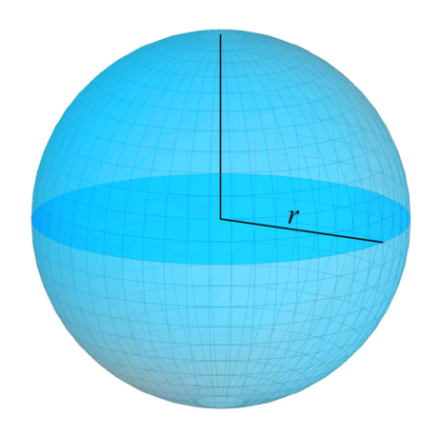
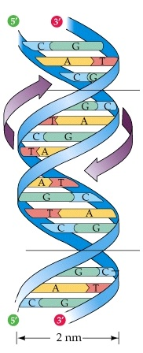
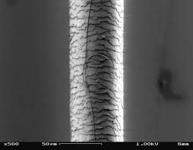
What is Nanoelectronics?
Nano Electronics
1 nm = 10⁻⁹m = 10 angstroms.
Atomic Van der Waals radius r: 0.3 to 3 angstroms.
Silicon Van der Waals radius: 2 angstroms.
Diameter of DNA helix: 2nm.,
Thickness of a cell membrane: 7.5nm.
Currently, commercially used, the smallest CMOS technology: 14nm.
Thickness of a human hair: 50um = 50000nm.
Sphere model of an atom
DNA helix
Human hair

Slide 3
What is Nanoelectronics?
Example:
Consider a human hair with a thickness of 50um. Suppose that the shape of a human hair is cylinder. Consider a nano transistor with dimensions of L=30nm, W=30nm, and H=10nm. How many transistors can we fit into a 1mm human hair?
> 200,000,000,000
Practically, where are we now in 2016?
A10 Fusion chip in Iphone7 has "over 3.3 billion" transistors with TSMC FinFET 16nm technology that fit in a die area of 150 square millimeters.

Slide 4
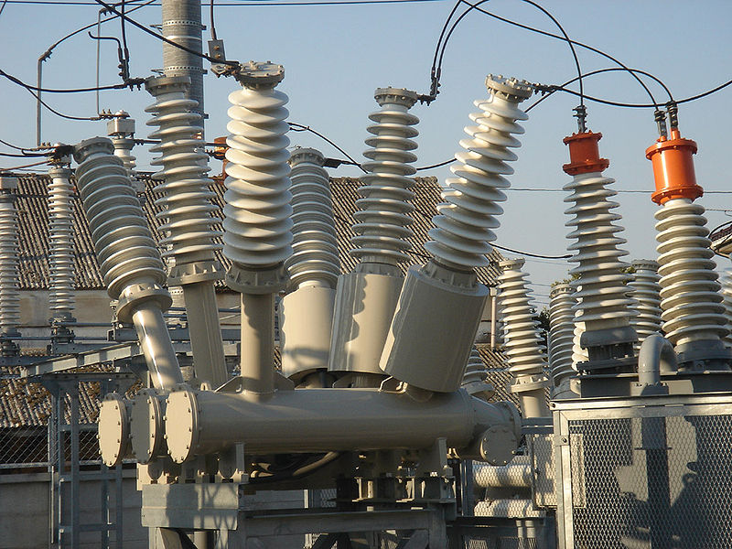
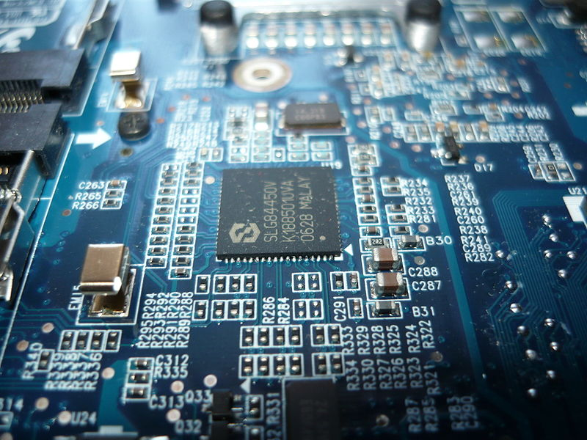
What is Nanoelectronics?
Nano Electronics
Electrical engineering
HIGH VOLTAGE/CURRENT
Power transmissions
Electrical machines
Electronics engineering
LOW VOLTAGE/CURRENT
Computers
Integrated circuits
Electrical
Electronics

Slide 5
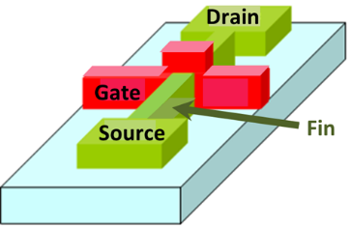
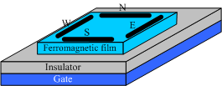
What is Nanoelectronics?
Nanoelectronics is not exactly nanoscale electronics, but emerging and nanoscale electronics.
New future technologies
Disruptive, completely new (disrupt an existing market)
In an exploratory phase, not commercially used
Beyond CMOS devices
FinFET transistor
Nanowire transistor
Spin wave switch
Single electron transistor

Slide 6
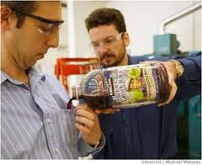
Why Nanoelectronics?
Non-stinky socks
Water resistant cloths
Main goal: to beat CMOS technology
CMOS shrinking problems
Moore’s Law’s anticipated limit, approaching the size of atoms
Short channel affects and leakage
Uncertainty, probabilistic phenomena
Fabrication challenges
Power challenges
10nm is seen as a critical point

Slide 7
Moore’s Law
1963: CMOS
1965: Moore’s Law
Transistor count doubles every year.
1975: Moore’s Law updated
Transistor count doubles every two years.
2015: Gordon Moore: «I see Moore’s law dying here in the next decade or so»
2015: Intel confirming the slowdown in pace of advancement, from two to two and a half years.
Uncertainty, probabilistic phenomena
Fabrication challenges
Power challenges
New technologies emerge

Slide 8
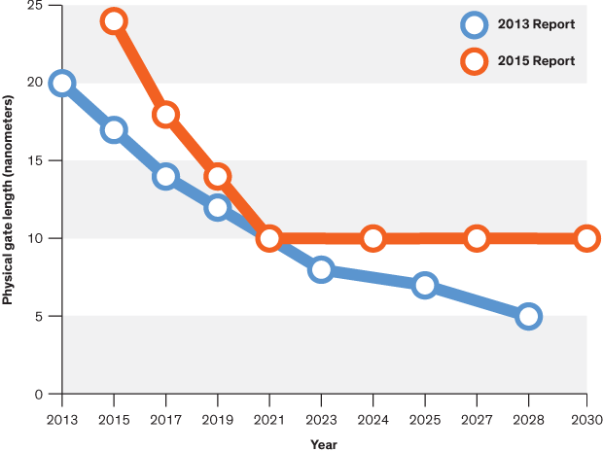
Critical Limits in Circuit Performance
f vs. year
Vdd vs. L
Energy ~ Vdd² × C
Power ~ Vdd² × C × f
C ~ Cox × W × L
Cox ~ 1/tox
f ~ 1/delay
P vs. year
L vs. year
delay~ W × L × 1/tox
* Vdd is limited by transistor threshold voltage
* tox is limited by leakage current
* W and L is limited by controllability
*Source: Computing’s Energy Problem in ISSCC, http://cpudb.stanford.edu/

Slide 9
Why Nanoelectronics?
Top-Down vs. Bottom-Up Fabrication
Top-Down
From a stone to a sculpture
More accurate
Lithography based
Traditional
Hard-to-manipulate in nanoscale
Bottom-Up
From separate molecular materials to an organized structure
Self-assembly
Regular arrays
More efficient
Self-assembled circuit with 64,000 elements in three minutes

Slide 10
Why Nanoelectronics?
Probabilistic phenomena
Every physical behavior is probabilistic!
The smaller the more probabilistic
Example:
A transistor with 1 electron vs. 10 electrons vs. 100,000 electrons in conduction. When applied a controlling gate voltage of 1V, each electron passes from source to drain with a probability of 0.9. What are the probabilities that the transistor conduct current (at least one electron passes from source to drain)?

Slide 11
Nanoelectronics Research
Dramatic increase in interest and funding of nanoelectronics.
Top funding agencies (Horizon 2020-$20b, NSF-$7b, NIH- $30b, Tubitak- $1b …) pour money to nanoengineering and emerging computing.
Leading universities have research groups on nanoelectronics.
The most prestigious conferences on circuit design DAC, ICCAD, DATE, and ISSCC have increasing number of papers targeting emerging technologies.
Better to add the word “nano and emerging” to your paper/presentation/proposal!

Slide 12
Computational Nanoelectronics
Theoretical
Physics rules – probability based
Quantum mechanics
The uncertainty principle
Schrödinger equation
Theory of relativity
Experimental
Fabrication processes
Self assembly
Computational
Computing 0s and 1s
Achieve logic and memory operations

Slide 13
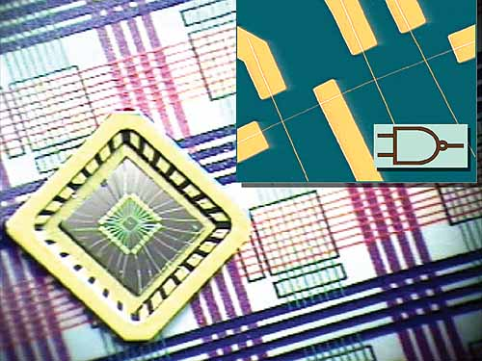
Computational Nanoelectronics
Nanocomputers get real
Ultra-tiny computer from an assembly of nanowires, Harvard University

Slide 14
Suggested Readings/Videos
Feynman, R. P. (1960). There's plenty of room at the bottom. Engineering and Science, 23(5), 22-36.
Iwai, H. I. R. O. S. H. I. (2009). Roadmap for 22nm and beyond.Microelectronic Engineering, 86(7), 1520-1528.
Conte, T.; Gargini, P. (2015), On The Foundation Of The New Computing Industry Beyond 2020, IEEE, International Technology Roadmap for Semiconductors (ITRS)
Richard Feynman Nanotechnology Lecture, 1984
http://www.youtube.com/watch?v=4eRCygdW--c

Slide 15
Course Information
A research course
Make you think out of the box
Unconventional
Math and circuit based icluding the probability theory
http://www.ecc.itu.edu.tr/index.php/ELE_523E

