Slide 1

ELE 523E
COMPUTATIONAL NANOELECTRONICS
Mustafa Altun
Electronics & Communication Engineering
Istanbul Technical University
Web: http://www.ecc.itu.edu.tr/
FALL 2016
W10-W11: Fault Tolerance, 21/11/2016-28/11/2016

Slide 2
Outline
Faults in Nano-crossbar arrays
  Diode-based
  FET-based
  Four-terminal switch based
Fault Tolerance Stages
  Fabrication
  Post-fabrication
  In-field
Post-fabrication and Defects in Nano-crossbar arrays
  Reconfiguration of a circuit
  Mapping with defects
    Defect-aware
    Defect-unaware
Analysis of in-field Transient Faults in Nano-crossbar arrays
  Diode-based
  FET-based
  Four-terminal switch based
General Transient Fault Tolerance Techniques
  Multiplexing and stochastic computing
  Dual modular redundancy (DMR) and triple modular redundant (TMR)
  Parity bits and Hamming codes

Slide 3
Faults in Nano-Crossbar Arrays
Ideally
f = A B + C D
With a fault
f = A B + B C D
With a fault
f = A + C D
How to tolerate faults?
Each crosspoint is either closed (diode connected) or open.
What if a crosspoint is closed when it is supposed to be open?
What if a crosspoint is open when it is supposed to be closed?

Slide 4
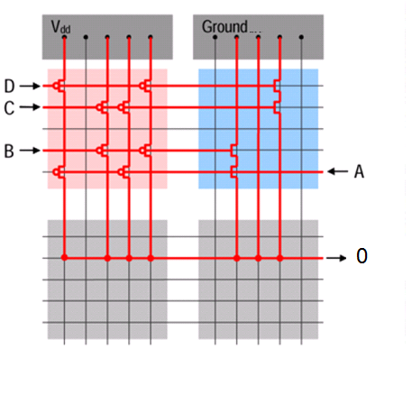
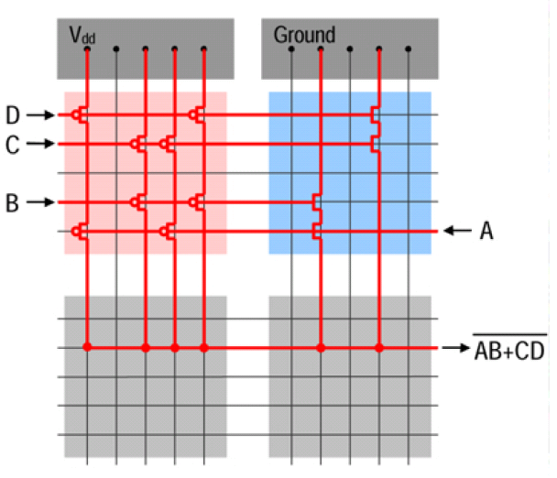
Faults in Nano-Crossbar Arrays
Ideally
f = (A B + C D)ꞌ
With a fault
f = 0
How to tolerate faults?
Each crosspoint is either closed (FET or shorted) or open.
What if a crosspoint is closed when it is supposed to be open?

Slide 5
Faults in Nano-Crossbar Arrays
Ideally
f = x₁ x₂ꞌ x₃+ x₁ x₄ꞌ + x₂ x₃ x₄ꞌ + x₂ x₄ x₅ + x₃ x₅
0
With a fault
f = x₁ x₂ꞌ x₃+ x₁ x₄ꞌ + x₂ x₃ x₄ꞌ + x₂ x₄ x₅ + x₃ x₅
1
With a fault
f = x₁ x₂ꞌ x₃+ x₁ x₄ꞌ + x₂ x₃ x₄ꞌ + x₂ x₄ x₅ + x₃ x₅
How to tolerate faults?
Each crosspoint is either closed or open depending on the applied literal.
What if a crosspoint is always closed when it is supposed to switch?
What if a crosspoint is always open when it is supposed to switch?

Slide 6
Fault Tolerance Stages
Stages: Fabrication
Post-fabrication
In-field/ Service
Stakeholder: Chip Manufacturer
Application Designer
End User
Mitigation Methods- Adding Redundancy: Error-correcting codes, TMR, NAND demultiplexing
Mitigation Methods: Configuring around defects
Mitigation Methods: Self-testing, reconfiguring
Permanent Faults
Permanent+
Transient Faults
Design
Nanomaterials: carbon nanotube, nanowires
Fabrication, verification and test
Final Product
Test and verification

Slide 7
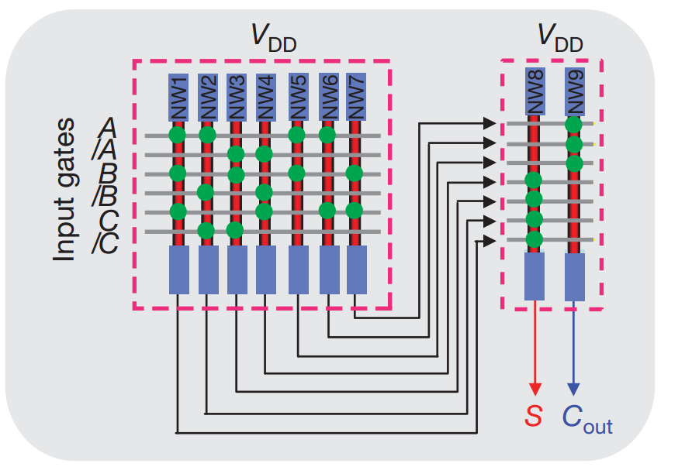
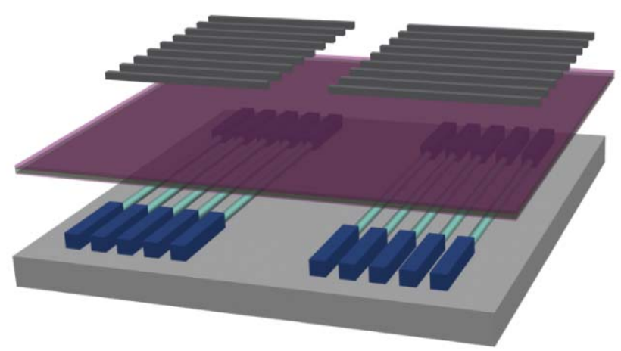
Post-fabrication and Defects
Nano-array fabricated with bottom-up methods
In post-fabrication, the ciruit is configured

Slide 8
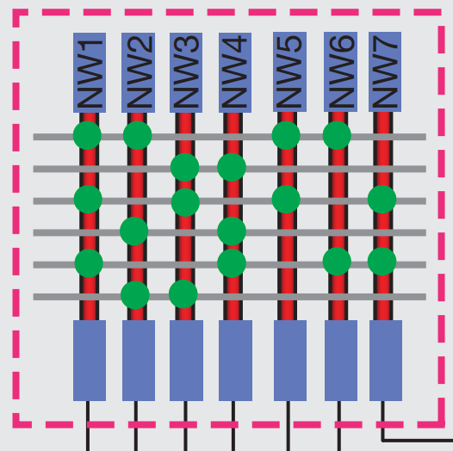
Configuration of a circuit
A logic function is implemented with configuration
A full-adder with activating and deactivating the switches
Activated
Deactivated

Slide 9
Configuration of a circuit
In a defect-free array, straitghtforward process
Input Lines
I₁ I₂ I₃ I₄ I₅ I₆
A B C A B C
O₁
O₂
O₃
O₄
O₅
O₆
O₇
Mapping
A B
B C
Output Lines
A C
A B C
Activated switch
Deactivated switch
F = A B + B C + A C + A B C
F = A B + B C + A C + A B C
(1) Given function
(2) Realized function

Slide 10
Defects
Stuck-at deactivated, switch cannot be activated
Stuck-at activated, switch cannot be deactivated
: Stuck-at deactivated switch
: Stuck-at activated switch
: Configurable switch
: Defective switch

Slide 11
Mapping with Defects
In a defective array, every mapping is not valid
Input Lines
I₁ I₂ I₃ I₄ I₅ I₆
A B C A B C
Mapping
A B
O₁
O₂
O₃
O₄
O₅
O₆
O₇
A B C
A C
Output Lines
A B C
Activated switch
C
Deactivated switch
F’ = A B + A B C + A C + A B C + C
F = A B + B C + A C + A B C
(2) Realized function
(1) Given function
F
F’

Slide 12
Defect-aware mapping
Mapping is performed with employing defects
Previous mapping
A B C A B C
Input Lines
I₁ I₂ I₃ I₄ I₅ I₆
B A C A B C
Mapping
A B
A B
O₁
O₂
O₃
O₄
O₅
O₆
O₇
B C
A B C
A C
A C
Output Lines
A B C
Activated switch
A B C
C
Deactivated switch
F = A B + B C + A C + A B C
F = A B + B C + A C + A B C
(1) Given function
(2) Realized function
F
F’

Slide 13
Defect-unaware mapping
First, a defect-free sub-array is found
Input Lines
I₁ I₂ I₃ I₄ I₅ I₆ I₇
I₁ I₂ I₃ I₄ I₅ I₆ I₇
O₁
O₂
O₃
O₄
O₅
O₆
O₇
Defect-free sub-aray
O₁
O₂
O₃
O₄
O₅
O₆
O₇
Output Lines
F = A B + B C + A C + A B C
(1) Given function
I₇ and O₅
discarded I₇

Slide 14
Defect-unaware mapping
Second, configuration is starightforward
Input Lines
I₁ I₂ I₃ I₄ I₅ I₆ I₇
A B C A B C
A B
O₁
O₂
O₃
O₄
O₅
O₆
O₇
B C
Mapping
A C
Output Lines
A B C
F’ = A B + B C + A C + A B C
F = A B + B C + A C + A B C
(2) Realized function
(1) Given function
F
F’

Slide 15
In-field Transient Faults
Transient faults occur according to a time-domain
They are predicted with probability analysis
Diode and FET Components show different behaviour regarding to the fault type
  Stuck-at OFF: switch is not capable of conducting current, infinite resistance
  Stuck-at ON: switch is constantly conducting current, zero resistance
Diode
Stuck-at OFF only switch
Stuck-at ON entire output line
FET
Stuck-at OFF entire output line
Stuck-at ON only switch

Slide 16
Diode-based Nanoarray
Stuck-at OFF, no connection between terminals
  Only faulty switch is affected
Stuck-at ON, terminals always connected
  Entire line is affected
Terminals
Gnd
Vdd
: Stuck-at OFF switch
: Stuck-at ON switch
: Functional switch
: Unusable switch

Slide 17
FET-based Nanoarray
Stuck-at OFF, no connection between terminals
  Entire line is affected
Stuck-at ON, terminals always connected
  Only faulty switch is affected
: Stuck-at OFF switch
: Stuck-at ON switch
: Functional switch
: Unusable switch

Slide 18
In-field Transient Faults
OFF-to-ON transition fault: The switch is ON when it is supposed to be OFF; x₁=0.
ON-to-OFF transition fault: The switch is OFF when it is supposed to be ON; x₁=1.
Each switch of the lattice has independent fault rates.

Slide 19
In-field Transient Faults
Ideally, if x₁=0 then all the switches are OFF.
Ideally, if x₁=1 then all the switches are ON.
We use redundancy in tolerating faults powered by percolation.

Slide 20

Percolation Theory
Rich mathematical topic that forms the basis of explanations of physical phenomena such as diffusion and phase changes in materials.
Broadbent & Hammersley (1957).

Slide 21
Percolation Theory
Sharp non-linearity in global connectivity as a function of random local connectivity.

Slide 22
Percolation Theory
p₂ versus p₁ for 1×1, 2×2, 6×6, 24×24, 120×120, and infinite size lattices.
Each square in the lattice is colored black with independent probability p₁.
p₂ is the probability that a connected path exists between the top and bottom plates.

Slide 23
Margins
One-margin: Tolerable p₁ ranges for which we interpret p₂ as logical one.
Zero-margin: Tolerable p₁ ranges for which we interpret p₂ as logical zero.
Margins correlate with the degree of fault tolerance.

Slide 24
Implementing Boolean Functions
signals in: x_{i}’s
signals out: connectivity top-to-bottom / left-to-right.

Slide 25
An Example with 16 Boolean Inputs
A path exists between top and bottom, f_{L} = 1

Slide 26
Margin Performance with a 2×2 Lattice
f_{L}=x₁x₃+x₂x₄ g_{L} =x₁x₂+x₃x₄
Different assignments of input variables to the regions of the network affect the margins.

Slide 27
One-margins (always good)
ONE-MARGIN
f_{L} =0
f_{L} =1
Fault probabilities exceeding the one-margin would likely cause an (1→0) error.

Slide 28
Good Zero-margins
ZERO-MARGIN
f_{L} =0
f_{L} =1
Fault probabilities exceeding zero-margin would likely cause an (0→1) error.

Slide 29
Poor Zero-margins
POOR
ZERO-MARGIN
f_{L} =1
f_{L} =0
Assignments that evaluate to 0 but have diagonally adjacent assignments of blocks of 1's result in poor zero-margins

Slide 30
Lattice Duality
A necessary and sufficient condition for good error margins is that the Boolean functions f_{L} and g_{L} are dual functions.

Slide 31
Lattice Duality
f_{L}=x₁x₃+x₂x₄ g_{L} =x₁x₂+x₃x₄
f_{L} ≠ g_{L}^{D}

Slide 32
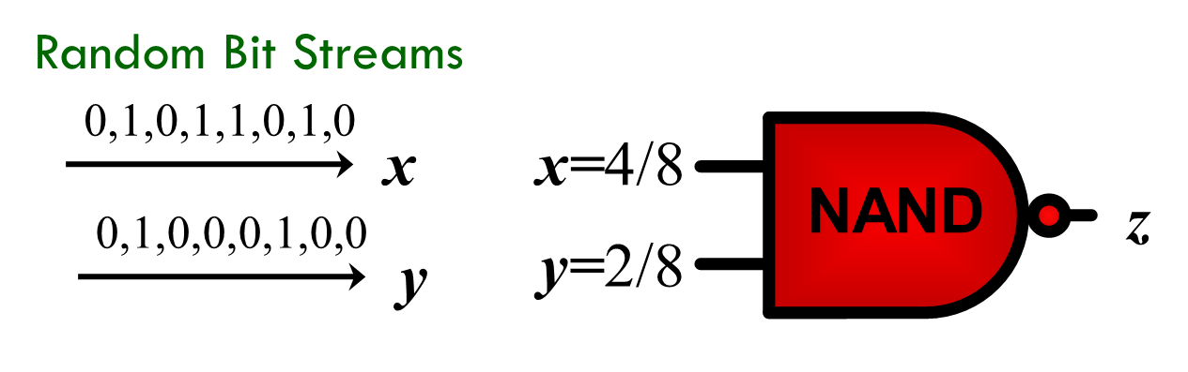
Transient Fault Tolerance
Von Neumann’s multiplexing unit, 1956
Randomly shuffled N number of inputs and outputs
Values are calculated as the number of 1 valued input/output lines over N
Parallel operation
Stochastic computing
Values are calculated as the number of 1 valued input/output lines over N
Serial operation

Slide 33
Multiplexing for Transition Faults
Error probability ϵ : a gate evaluates the incorrect result, the complement of the correct Boolean value, with ϵ.
Calculate z with and without error
ϵ ⟶ ϵ(1-2z)

Slide 34
Multiplexing for Stuck-at 1 Faults
Error/fault probability ϵ : each gate constantly evaluates logic 1 with ϵ.
Calculate z with and without error
ϵ ⟶ ϵ(1-z)

Slide 35
Multiplexing for Stuck-at 0 Faults
Error/fault probability ϵ : each gate constantly evaluates logic 0 with ϵ.
Calculate z with and without error
ϵ ⟶ ϵ(z)

Slide 36
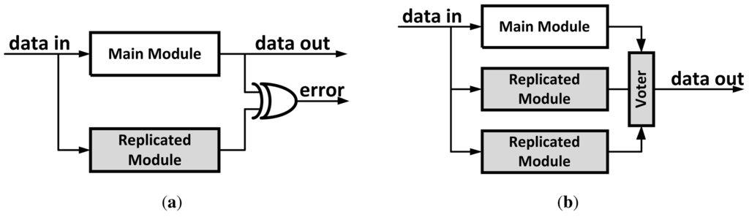
Transient Fault Tolerance
Dual modular redundancy (DMR)
Increase area 2 times plus an XOR gate
For only a single output fault
For only detection
Triple modular redundancy (TMR)
Increase area 3 times plus XOR gates
For only a single output fault
For both detection and correction

Slide 37
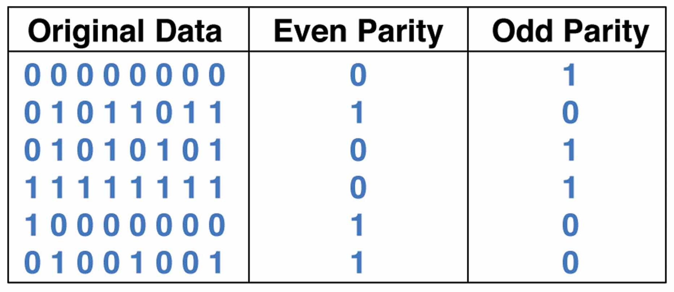
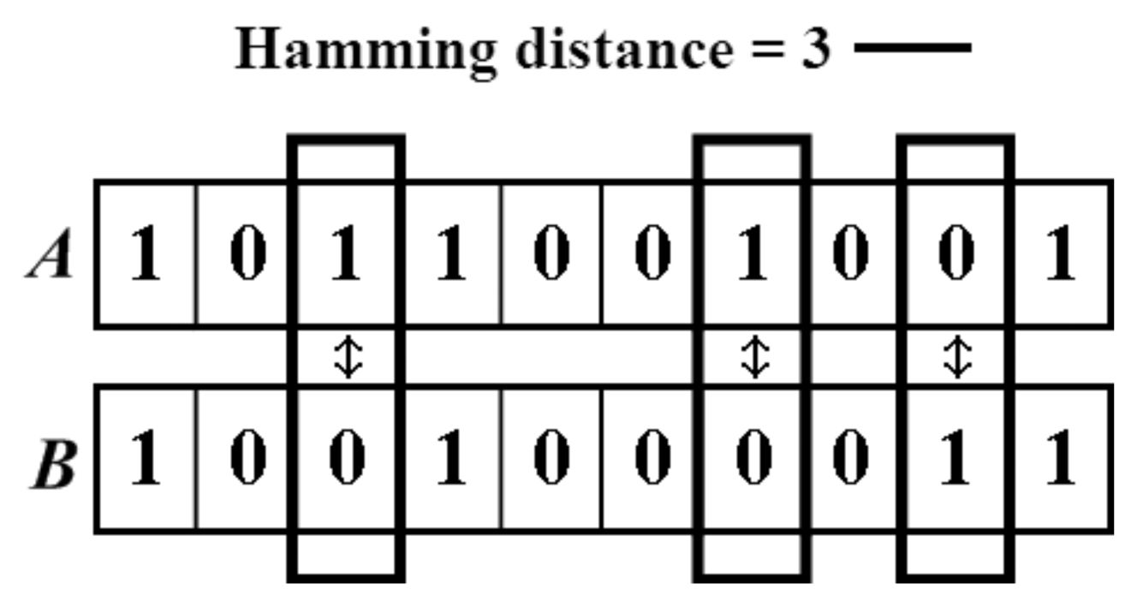
Transient Fault Tolerance
Extra parity bit
Applicable for large circuits
For only odd number of output faults
For only detection
Satisfying Hamming distance
Practical for large circuits
For multiple output faults
For both detection and correction

Slide 38
Suggested Readings
DeHon, A. (2003). Array-based architecture for FET-based, nanoscale electronics. Nanotechnology, IEEE Transactions on, 2(1), 23-32.
Han, J., & Jonker, P. (2003). A defect and fault-tolerant architecture for nanocomputers. Nanotechnology, 14(2), 224.
Rao, W., Orailoglu, A., & Karri, R. (2007, April). Logic level fault tolerance approaches targeting nanoelectronics plas. In 2007 Design, Automation & Test in Europe Conference & Exhibition (pp. 1-5). IEEE.
Altun, M., & Riedel, M. D. (2011). Robust Computation through Percolation: Synthesizing Logic with Percolation in Nanoscale Lattices. International Journal of Nanotechnology and Molecular Computation (IJNMC), 3(2), 12-30.
Tunali, O., & Altun, M. (2016) Permanent and Transient Fault Tolerance for Reconfigurable Nano-Crossbar Arrays. IEEE Transactions on Computer-Aided Design of Integrated Circuits and Systems.

