Slide 1
This project has received funding from the European Union’s Horizon 2020 research and innovation programme under the Marie Skłodowska-Curie grant agreement No 691178.
Spin-Torque Memristor based Offset Cancellation Technique for Sense Amplifiers
Mesut ATASOYU

Slide 2
Introduction
The IRRO cancellation in sense amplifiers with the aid of the spin-torque memristor technology.
The proposed structure employs a non-destructive sensing scheme in order to achieve a relatively large sense margin by reducing the IRRO.
The spin-torque memristors in series perform less resis-
tance and process variations from parallel connection.

Slide 3
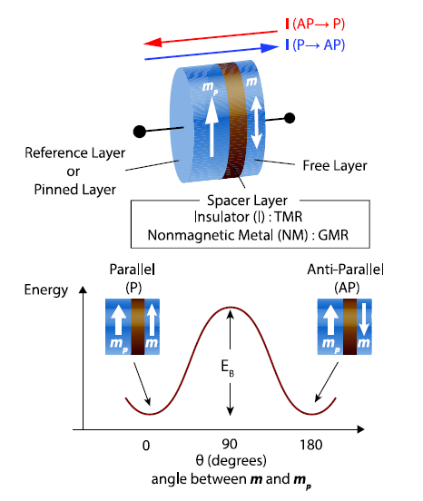
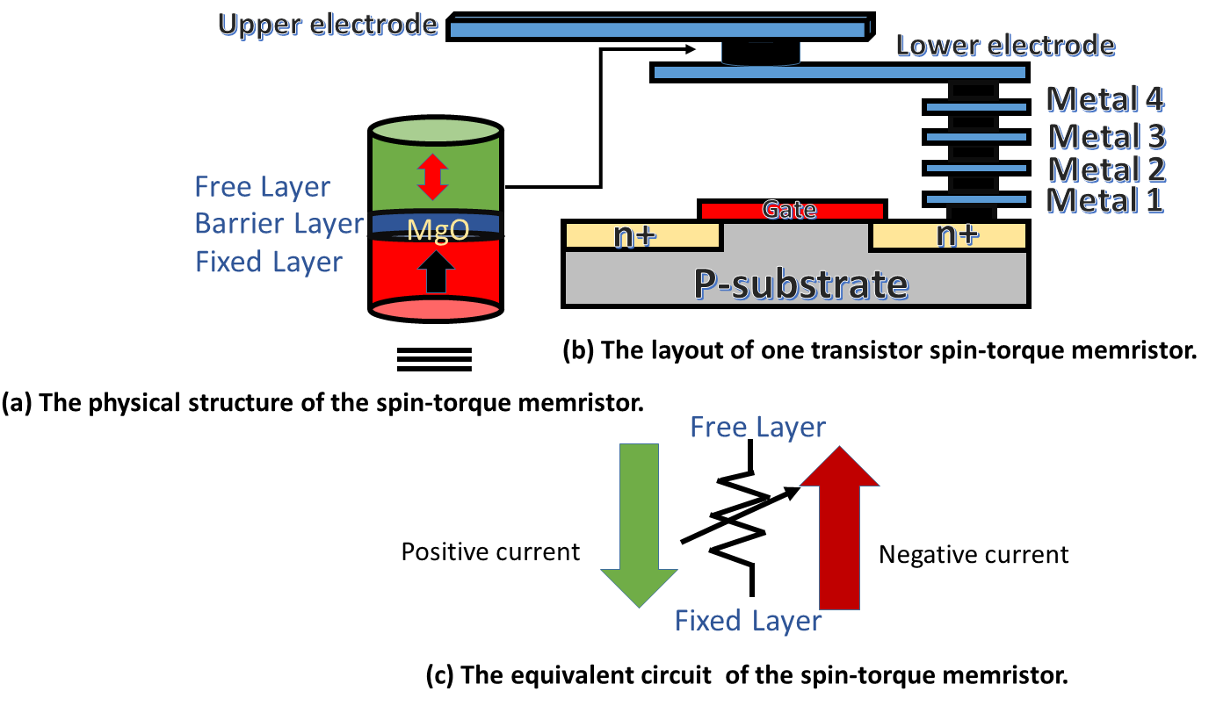
Magnetic Tunnel Junctions
Notes:
TMR RESISTANCE measures LOW resistance at PARALLEL configuration FREE AND PINNED LAYER EACH OTHER. OTHERWISE TMR IS HIGH ANTI PARALLEL EACH OTHER. Basically, two metal ferro magnet separated by a thin insulator layer, commonly use MgO2. Electrons goes by tunneling to thinner oxide layer.

Slide 4
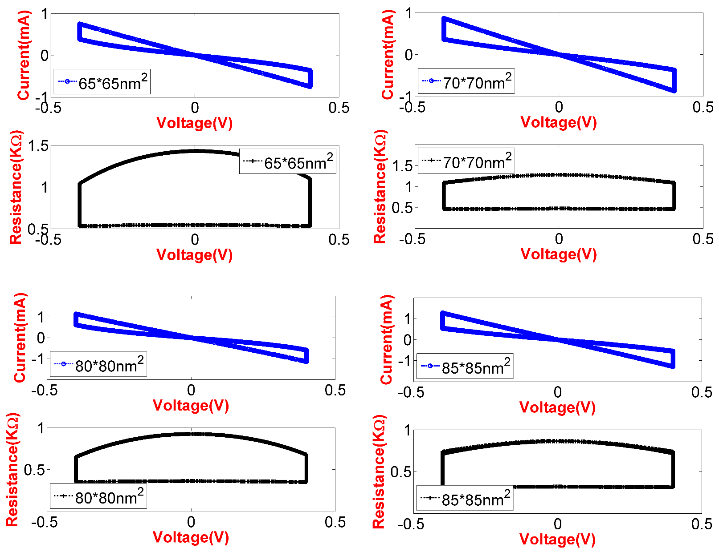
The Resistance Values of The Proposed MTJs

Slide 5
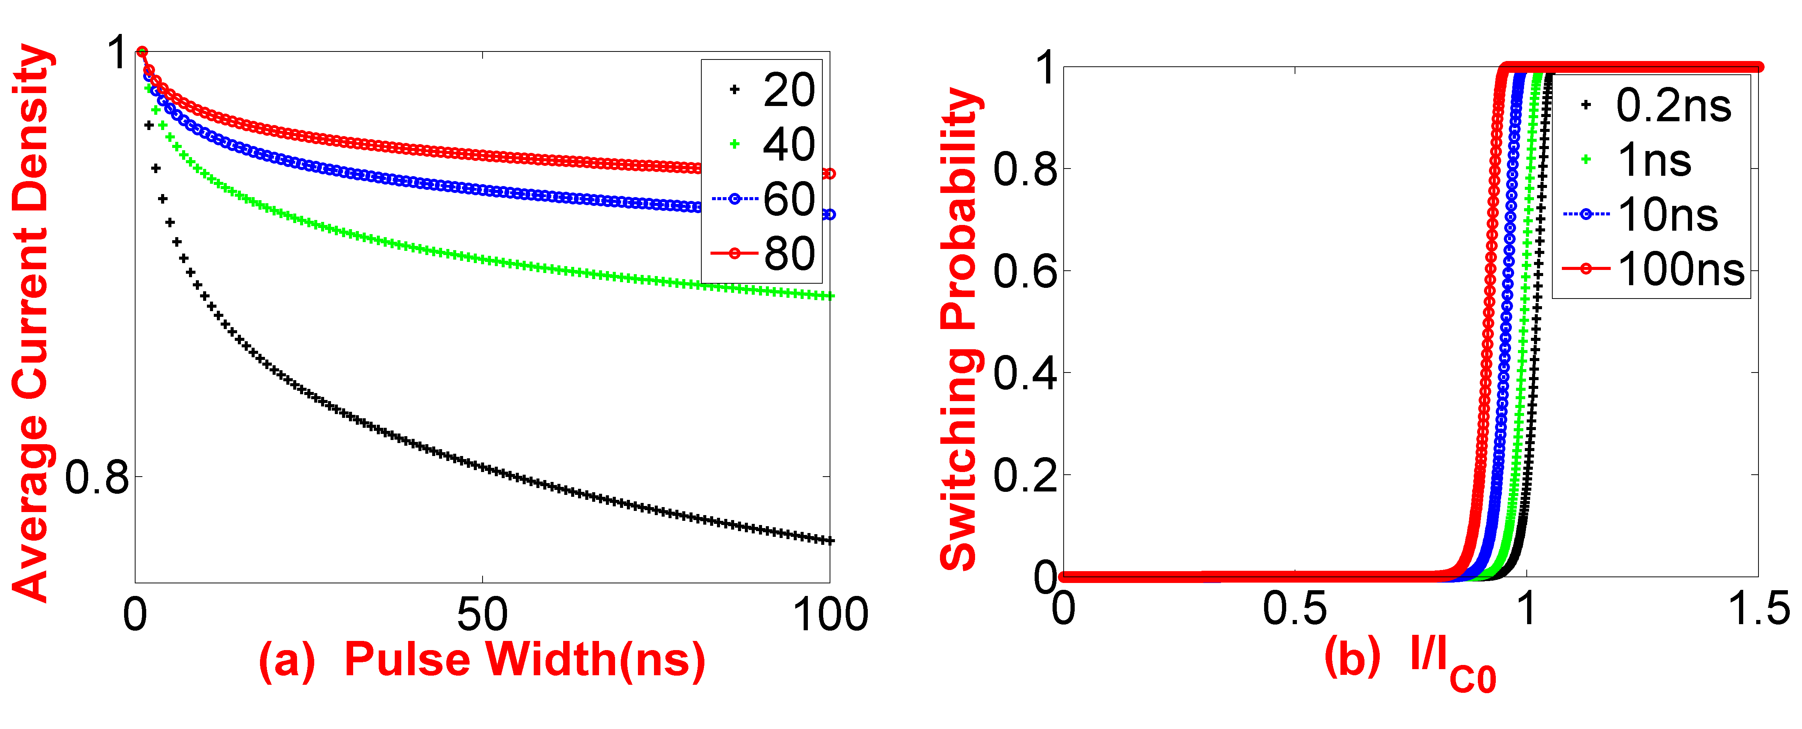
Magnetic Tunnel Junctions

Slide 6
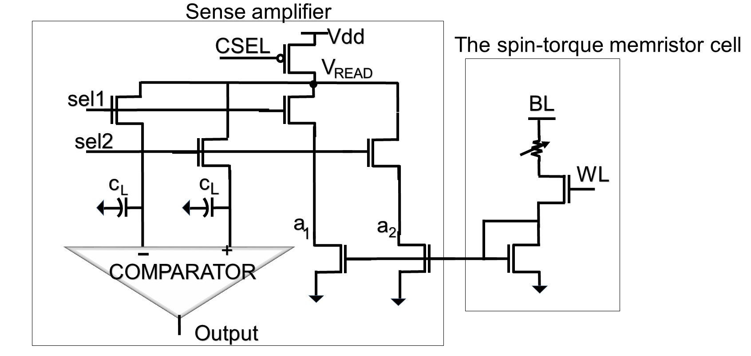
The Proposed Sense Amplifier

Slide 7
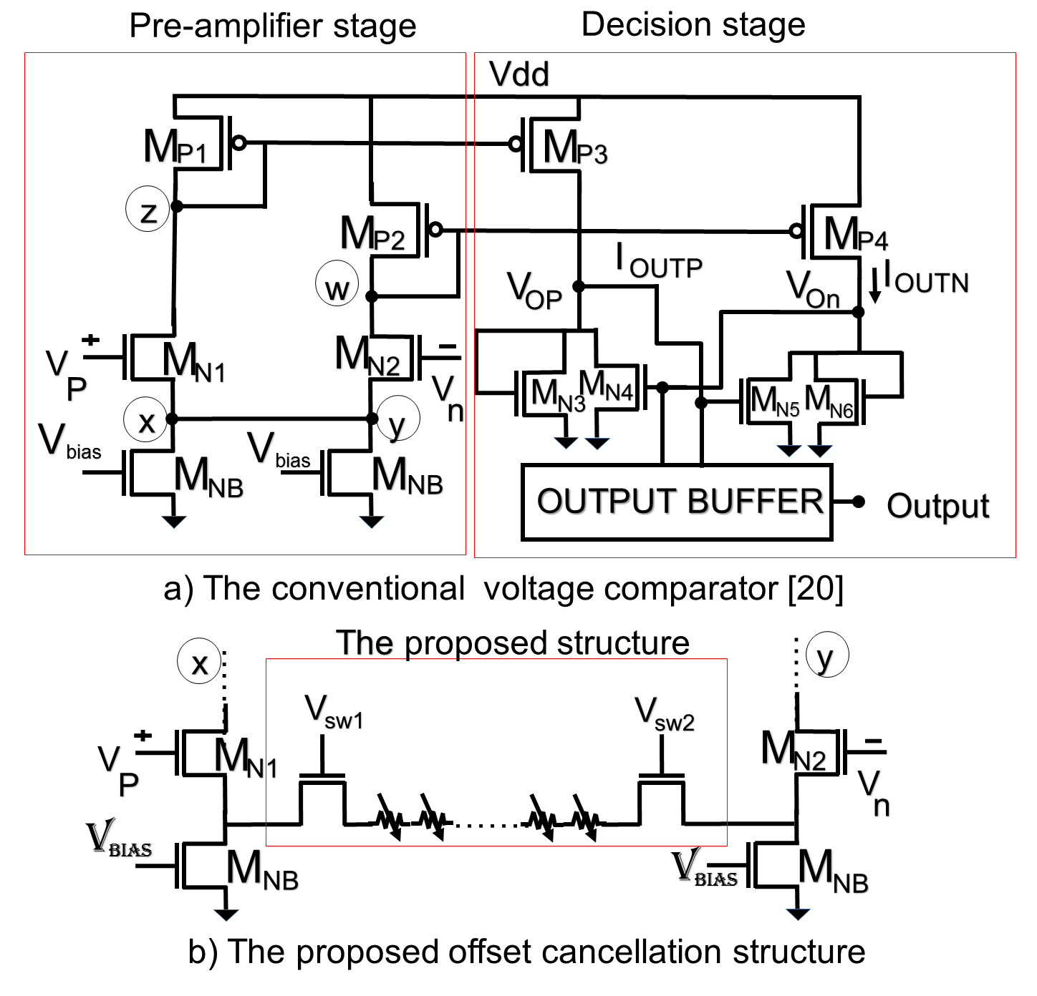

Slide 8
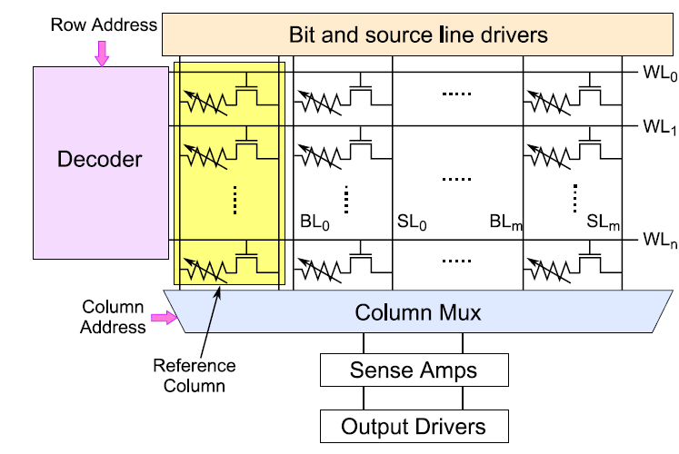
Memory Array Structure

Slide 9
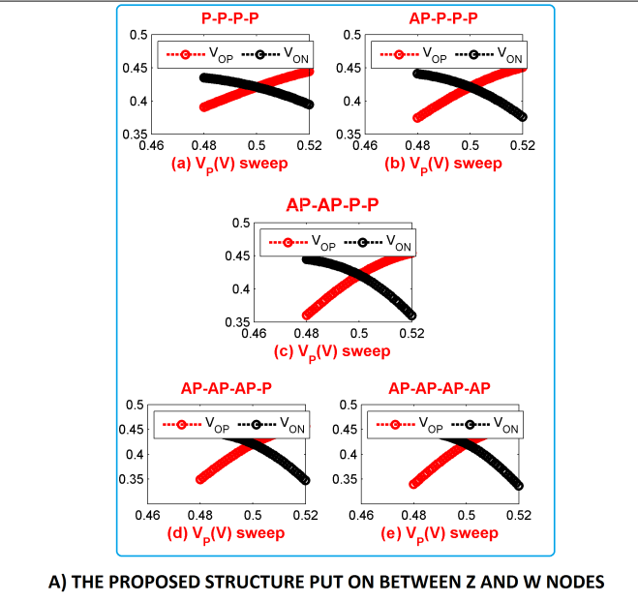
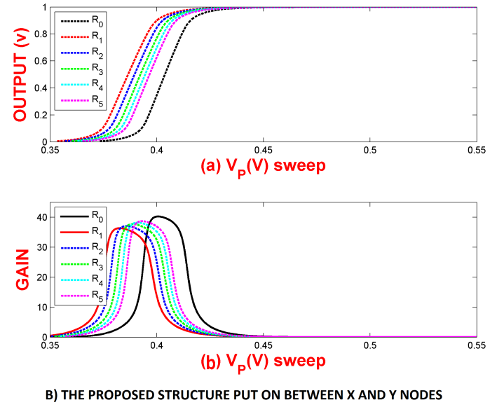
Results

Slide 10
Conclusion
Easily switching
Low power design
The current matching on the input transistors
The overwrite problem of the spin-torque memristor

