Slide 1
Extensive Investigation of Calibrated Accelerated Life Testing (CALT) in Comparison with Classical Accelerated Life Testing (ALT)
Burak Sal (Presenter),
M. Altun
Istanbul Technical University, Istanbul, Turkey

Slide 2
Motivation
CALT uses 6 samples
ALT uses 100 samples
WHICH ONE DO YOU CHOOSE ?
6 samples < 100 samples
Is it though?
Is it though?
So choosing CALT will be the best way ever!!!!
Is it though?
Is it though?
What about the time that CALT has to run until the sample fails?
What about the accuracy?

Slide 3
OUTLINE
Introduction
Definition of ALT and CALT
General Test Mechanism
Life-Stress Plot of CALT
Performance Parameters
Bounds Ratio
Calculation of Performance Parameters
Comparison of ALT and CALT with changing performance parameters
Failure Rate Comparison
Acceleration Factor Comparison
Case Studies
Threshold Values of ALT and CALT
Case Studies
Case Study - 1
Case Study - 2
Case Study - 3
Conclusion

Slide 4
Definiton of ALT and CALT
Accelerated Life Testing (ALT) and Calibrated Accelerated Life Testing (CALT) are mainly used test methods.
Also Highly Accelerated Life Testing (HALT) is used before these testing methods to determine absurd stress levels.
ALT uses analytical equations to determine test stress level and sample size.
CALT uses profile methods for stress levels and 2 sample size for each profile. Each profile is %10 reduced version of previous level.

Slide 5
General Test Mechanism
HALT
CALT
2. Profile (%10 Reduced of 1. Profile)
3. Profile (%10 Reduced of 2. Profile)
ALT
Analytical Calculations
1. Profile (%10 Reduced of HALT)

Slide 6
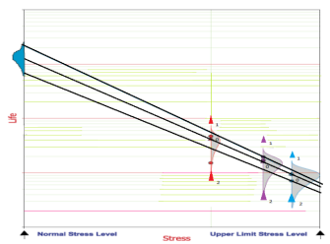
Life-Stress Plot of CALT
CALT’s Life-Stress plot is controversial because of few stress points are determined.

Slide 7
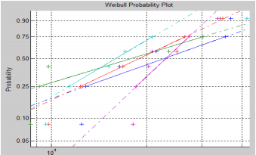
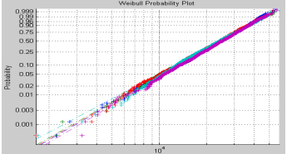
Performance Parameters – Bounds Ratio
Bounds Ratio affects accuracy with failure rate and sample size.

Slide 8
Calculation of Parameters - ALT
Reliability, R(t)= exp(-WT/MTTF)
R(t)= exp(-t/n )^β
β= Beta, n= Eta, t= WT (hours)
AF=exp[(Ea/k)*(1/Tfield-1/Ttest)]
Ea= Activation Energy, Tfield= Field Temperature, Ttest= Test Temperature,
n1 /AF= n2
P1= 1-exp(-t/n1)^β, P2= 1-exp(-t/n2)^β
P1 and P2 Probability of Failure values, t= Estimated Time (hours), k= Boltzmann constant

Slide 9
Calculation of Parameters - ALT
Bounds Ratio= Upper Limit/Lower Limit
lnTp+ z*std(lnTp)= Upper Limit
lnTp- z*std(lnTp)= Lower Limit
Tp= Standard Deviation, z= Normal Distribution Parameter.
Sample Size= (z*A*BR)^c
A= Average variance coefficient,
c= Distribution Parameter.
Unit Test Time= (Normal Yearly Time*Warranty Time)/AF
Total Test Time= Sample Size × Unit Test Time

Slide 10
Calculation of Parameters - CALT
Sample Size= 6
Recommended sample size for CALT is 6, however, sample size can be increased in order to increase accuracy.
Unit Test Time= (Normal Yearly Time*MTTF)/AF
Total Test Time= Sample Size × Unit Test Time

Slide 11
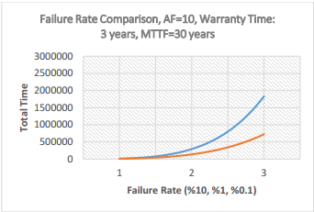
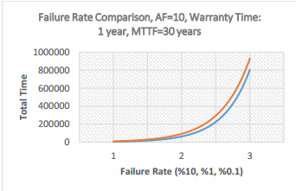
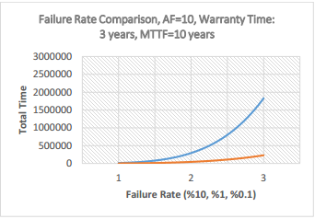
Comparison of ALT and CALT – Failure Rate
We have compared FR (%10, %1, %0.1) and accuracy levels of ALT and CALT by the changing of WT and MTTF.
calt
alt
alt
alt
calt
calt

Slide 12
Accuracy Comparison with Failure Rate levels
Accuracy Comparison FR=%10, MTTF=30 years, WT=3 Years.
Accuracy Comparison FR=%0.1, MTTF=30 Years, WT=3 Years.
Accuracy Comparison FR=%1, MTTF=30 years, WT=3 Years.
ALT | CALT
%100 | %97
ALT | CALT
%100 | %50
ALT | CALT
%100 | %14
Accuracy Comparison FR=%10, MTTF=30 Years, WT= 1 year.
Accuracy Comparison FR=%1, MTTF=30 Years, WT= 1 year.
Accuracy Comparison FR=%0.1, MTTF=30 Years, WT= 1 year.
ALT | CALT
%100 | %98
ALT | CALT
%100 | %70
ALT | CALT
%100 | %45
Accuracy Comparison FR=%10, MTTF=10 Years, WT= 1 year.
Accuracy Comparison FR=%1, MTTF=10 Years, WT= 1 year.
Accuracy Comparison FR=%0.1, MTTF=10 Years, WT= 1 year.
ALT | CALT
%100 | %99
ALT | CALT
%100 | %84
ALT | CALT
%100 | %62

Slide 13
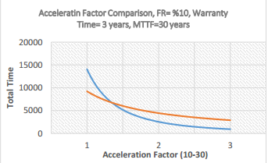
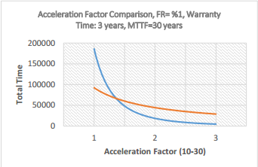
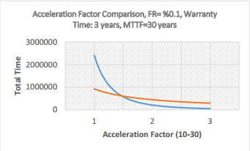
Comparison of ALT and CALT – Acceleration Factor
We have compared AF (10, 20, 30) and accuracy levels of ALT and CALT by the changing of FR.
alt
alt
calt
calt
calt
alt

Slide 14
Accuracy Comparison with Acceleration Factor levels
Accuracy Comparison FR=%10, MTTF=30 years, WT=3 Years, AF=10
Accuracy Comparison FR=%0.1, MTTF=30 Years, WT=3 Years. AF=10
Accuracy Comparison FR=%1, MTTF=30 years, WT=3 Years. AF=10
ALT | CALT
%100 | %97
ALT | CALT
%100 | %50
ALT | CALT
%100 | %14
Accuracy Comparison FR=%10, MTTF=30 Years, WT= 1 year, AF=20
Accuracy Comparison FR=%1, MTTF=30 Years, WT= 1 year, AF=20
Accuracy Comparison FR=%0.1, MTTF=30 Years, WT= 1 year, AF=20
ALT | CALT
%100 | %100
ALT | CALT
%100 | %97
ALT | CALT
%100 | %50
Accuracy Comparison FR=%10, MTTF=10 Years, WT= 1 year, AF=30
Accuracy Comparison FR=%1, MTTF=100 Years, WT= 1 year, AF=30
Accuracy Comparison FR=%0.1, MTTF=10 Years, WT= 1 year, AF=30
ALT | CALT
%100 | %100
ALT | CALT
%100 | %98
ALT | CALT
%100 | %72

Slide 15
Threshold Values for ALT and CALT Usage
ALT and CALT can not be used under these values.
TfW=10 hours
TfW=30 hours
AF | ALT | CALT
10 | 180 hours | 1750 hours
20 | 90 hours | 900 hours
30 | 70 hours | 465 hours
AF | ALT | CALT
10 | 54 hours | 525 hours
20 | 27 hours | 270 hours
30 | 21 hours | 140 hours

Slide 16
Case Study - 1
We determined wanted input values and chose one of the test methods.
Input Values | ALT | CALT
AF=10 MTTF=30 years WT=3 years BR= 5 TT= 1000 hours TfW= 10 hours | FR=%9.5 SS=11 Accuracy=%9 TT=1000 hours | CAN NOT BE USED. (IT IS UNDER THE THRESHOLD VALUE)

Slide 17
Case Study - 2
We determined wanted input values and chose one of the test methods.
Input Values | ALT | CALT
AF=20 MTTF=30 years WT=3 years BR= 5 TT= 1000 hours TfW= 3 hours | FR=%9.5 SS=20 Accuracy=%100 TT=652 hours | FR=%9.5 SS=5 Accuracy=%98 TT=1000 hours

Slide 18
Case Study - 3
We determined wanted input values and chose one of the test methods.
Input Values | ALT | CALT
AF=20 MTTF=30 years WT=3 years BR= 5 TT= 500 hours TfW= 3 hours | FR=%9.5 SS=15 Accuracy=%76 TT=500 hours | FR=%9.5 SS=3 Accuracy=%41 TT=500 hours

Slide 19
Conclusion
We show that even though CALT uses fewer sample size than ALT, its accuracy and total test time can not beat ALT in some levels.
Also, we support that result with parameter calculations, graphs and case studies.
Our future work will be ‘Dynamic Test Method’ which can be used with one by one sample and performance parameter will change to arrange wanted test results.

Slide 20
Thank you for listening
Any Questions?
Info: salb@itu.edu.tr

